Slide 1

One French translation for the French-speaking world
François MACARY- International Projects Lead, PHAST
09/04/2020

Slide 2



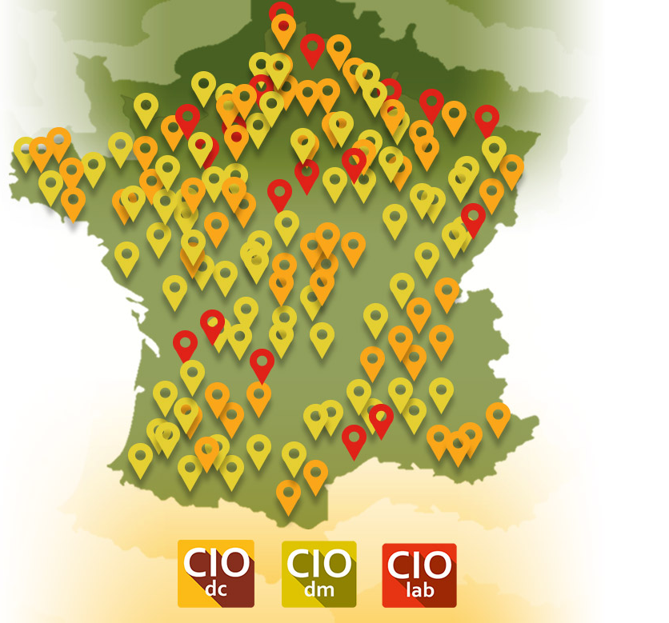





SNOMED CT Translation agreement signed in 2015
contributes
inserts
Standard Development Organizations:
HL7, IHE, SNOMED, Regenstrief, GMDN …
adapts
National regulatory framework
deploys
Health Terminology Server
Health products & services Catalog Server
Semantic metathesauri
Drugs
Medical devices
Laboratory medicine
Terminological expertise to EMR & app vendors
2

Slide 3
PHAST’s use of SNOMED CT
Laboratory medicine:
  order clinical context (e.g. reason, symptoms, condition, treatment, procedure …)
  in vitro diagnostic specimens and containers
  qualitative results in laboratory medicine (e.g. microbiology)
Drugs:
  clinical drugs, ingredients, strengths
  dose forms, administration routes
  contraindications and indications
Medical devices:
  Categories of devices
Clinical use:
  Build value sets (patient history, reason for encounter, allergies …), and mappings
3

Slide 4
The French Translation Project Group
Belgium
  NRC: Service public fédéral - Santé publique, sécurité de la chaîne alimentaire et environnement (Katrien Scheerlinck, Ingrid Mertens, David Op de Beeck)
  Cliniques Universitaires Saint-Luc UCL (Claire Beguin)
Canada
  NRC: Health Infoway (Linda Parisien)
France
  PHAST (Valérie Desbois-Pelissier, Emilie Nguyen, Olivier Boux, François Macary)
Luxembourg
  NRC: Agence eSanté (Raffaella Vaccaroli, Samuel Danhardt)
Switzerland
  NRC: eHealth Suisse (Pero Grgic, Juerg Bleuer)
  Geneva University Hospitals (Christian Lovis, Christophe Gaudet-Blavignac)
  Haute Ecole de Gestion de Genève (Anaïs Mottaz, Luc Mottin)
www.health.belgium.be
www.saintluc.be
www.infoway-inforoute.ca
www.phast.fr
www.esante.lu
www.e-health-suisse.ch/
www.unige.ch/medecine/simed/en/
www.hesge.ch/heg/
4

Slide 5




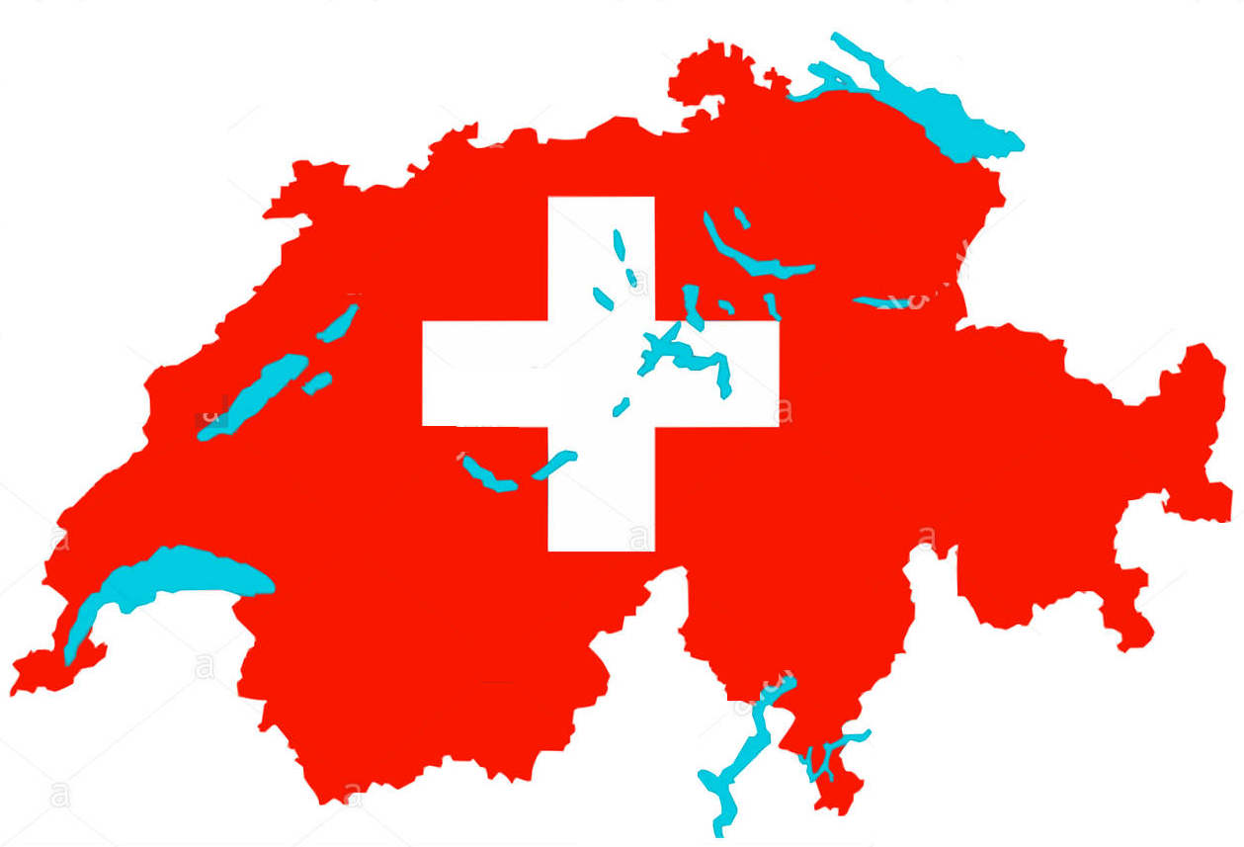
French translation archipelago in 2018
Belgium FR 20180915
38003 active concepts
Canada FR 20180430
37102 active concepts
~ 700 concepts translated for cross-border care in Europe
PHAST FR
4810 active concepts
Starter Set 20180131
6340 active concepts
5

Slide 6
2018: A suboptimal organization
Each country had elaborated its own translation guidelines
Overlap: More than 10% of concepts translated more than once
Discrepancies across translated terms (vocabulary, syntax, use of punctuation signs, character case)
Variability of processes and translation tools
6

Slide 7
September 2018: First meeting convened in Paris by PHAST
Unlike English language, French language has a unique authoritative source
  A single authoritative spelling, backed by Académie française
  A single grammar
Yet, vocabulary dialectal variations do exist across francophone countries
French translation resources are scarce in each country
Decisions:
  Join strengths to build a single French translation
  Cover the dialectal vocabulary variations
  Elaborate a common French translation guideline
  Set a common production framework and a collaborative process
7

Slide 8
Method
Decision making process within the French Translation Project Group
  Seek unanimous approval for each choice made
  Minimum threshold is unanimity minus one
Elaboration of the French translation guidelines
  Cross-review of existing national French translation guidelines
  Selection and formulation of each rule submitted to approval of the group
Handling dialectal vocabulary variations
  Produce enough synonyms to cover the needs of all French-speaking areas
  For each concept, pick the most consensual synonym as the default preferred term
  Localize preferences (preferred | acceptable | not acceptable) by exception
  To improve efficiency we need to work together in a common framework
  Avoid the risk of redundant work (e.g. translate twice the same concept)
  Avoid the risk of discrepancies of translation (e.g. within a sub-hierarchy)
8

Slide 9
Translation Scope
Limited to concepts belonging to the international edition
  Concepts created in national extensions are translated locally by the NRC, and stay local
  Driven by use cases brought by each contributing country
  No objective of comprehensiveness of the translation
  We translate the concepts needed by existing use cases
  No translation of FSN (unanimity minus one)
  Agreement to rely on the core FSN (en-US)
  Having more than one FSN per concept makes maintenance heavier
9

Slide 10
Translation Approach (consequence of use case driven) 1/2
A use case communicates its needs in the native language of the users promoting this use case
  Thus, concepts needed are expressed in the native French language of practitioners
  Therefore we are not translating a corpus of terms from English to French (like one would do to translate a lexicon)
  The process looks more like the other way round (see next slide)
10

Slide 11
Translation Approach (consequence of use case driven) 2/2
  Translation steps:
  The concept needed is expressed through a collection of meaningful French terms (one or more) used by practitioners.
  Select the SNOMED CT concept representing the same clinical idea, based on its relationships and FSN (en-US).
  Rather than translating existing English terms to French, use the French terms provided by step 1, as the candidate French synonyms.
  Apply the FR translation guidelines to these candidate synonyms. This may eventually slightly modify some of the terms and may also add more synonyms.
  Check acceptability for each French-speaking area. This step may add more synonyms.
  Pick the default preferred term for the Common French Translation (international).
  Modulate acceptability locally by exception, for each participating country.
11

Slide 12
Process set up
The French translation is a collaboration across Members and Affiliates
It needs a collaborative framework to be hosted and sustained
Canada Health Infoway has volunteered to provide this framework
The framework chosen, termSpace, adapted to support smoothly the multi-NRC translation process
A lot of tasks have been conducted in parallel:
  Elaborating version 1 of the guidelines
  Setting up the technical environment for the group
  Merging the existing translations and performing automated QA on them
  Adapting the tool to this new multi-NRC translation process
  Learning how to use the tool
  Jumping to the interim version 20200309
12

Slide 13
First achievement: Version 1 of translation and guidelines
Based on interim international edition 20200309
Merges the existing pieces:
Dated of March 10, 2020, includes the new concepts related to covid-19
Integrated to Canada national edition 20200331. Be aware that the translated FSN are specific to the Canadian edition.
Loaded into PHAST’s FHIR terminology server & SNOMED CT browser
Alignment with the common guidelines not complete. To be continued on version 2 planned for September
Merged translation | #Translated Concepts
1 Canada | 35520
2 Belgium | 40218
3 Starter Set | 6207
4 Phast | 7033
TOTAL | 77027
13

Slide 14
Need a flexible process letting each NRC evolve at its own pace
Common French Translation Framework
Editorial translation guidelines
Export local fr translation
Change Management
Common fr Translation
Set local preferences
NRC
Global Review
Local Translation
Preference Management
Import common fr translation
Local Review
Publication
NRC with an ongoing local translation process
Contribute to all tasks in the framework
Set local preferences
NRC
NRC
Import common fr translation
Import common fr translation
NRC with resources working directly in the common framework
NRC without any resources for translation
14

Slide 15

Questions?
Learn more:
https://confluence.ihtsdotools.org/display/FTCG/French+Translation+Collaboration+Group
Wish to participate to the group? igr@snomed.org
Questions to Phast? contact@phast.fr

