Slide 1

SNOMED CT and SNOMED International
Nursing CRG
Ian Green 17th, March 2020

Slide 2



About SNOMED International
Owned and governed by 39 Member countries,
SNOMED International is a not-for-profit organization charged with setting global standards for health terminology
Headquarters
in London
Virtual organization
& global workforce
Membership dues based
on National wealth

Slide 3

Our Members
SNOMED International is a Member-owned organization.
Our dedicated Customer & Stakeholder Relationship Management team includes regional representatives, clinical and vendor engagement programs and collaboration support for our Members.
Members are an agency of a national government,
or a corporation or regional government agency
endorsed by a national government authority.

Slide 4
What is SNOMED CT?
“The world’s most comprehensive multilingual clinical language”
A resource with comprehensive, scientifically validated clinical content
Enables consistent representation of clinical content for processing in electronic health records
Maps to international standards (ICD-10, OPCS-4, GMDN, ICPC-2, LOINC, etc.)
Used in more than eighty countries
SNOMED CT supports
  Detailed recording of relevant clinical data, that can be patient focused
  Effective retrieval of clinical information
  Communication of clinical data interoperably
Notes:
Authors research evidence based articles and journals to ensure that the SNOMED content is modelled correctly and is not just accurate but clinically validated as well
Even in a single hospital clinicians can refer to clinical ideas by different names or terms or abbreviations, so internationally this can increase significantly, and that can bring challenges to ensure that we are still taking about the same thing. SNOMED ensures that these idea can be represented in a number of different ways by allowing the addition of various descriptions that can be searched and retrieved.
There are a number of maps from SNOMED to a number of various international standards. These are done by specialist mappers you have domain knowledge of the source and targets of these maps.
The increasing use of SNOMED across the world is showing the fantastic possibilities and benefits of SNOMED in enhancing interoperability.

Slide 5
How is SNOMED CT Created?
Four basic principles guide the development of clinical content and technical design:
Inclusive involvement of diverse clinical groups and medical informatics experts.
Quality focused content development with adherence to strict editorial rules.
Quality improvement process open to public scrutiny & input.
Minimal barriers to adoption and use.
Notes:
Medical terminologies are complex and SNOMED is no exception, the SNOMED community is internationally inclusive, and there are a number of areas of active collaboration with domain experts.
SNOMED Ed guide enforces rules to ensure terminology is developed in a standardised and controlled manner, supported by technical tools like the Machine Readable Concept Model, as well as peer reviews by fellow authors
With every release of SNOMED we are working to improve Quality and this next release is focussing on Quality of existing content…We have a number of process that not only allow transparency of where the Quality issues are, but also take on feedback to aid the entire process
We want to work to make it as easy as possible to use and adopt SNOMED and we offer Open Source software tools and provide support services and assistance where we can to remove any barriers to understanding or using SNOMED from individuals and National Release Centres like yourselves to Partners and Vendors implementing SNOMED in their systems.

Slide 6
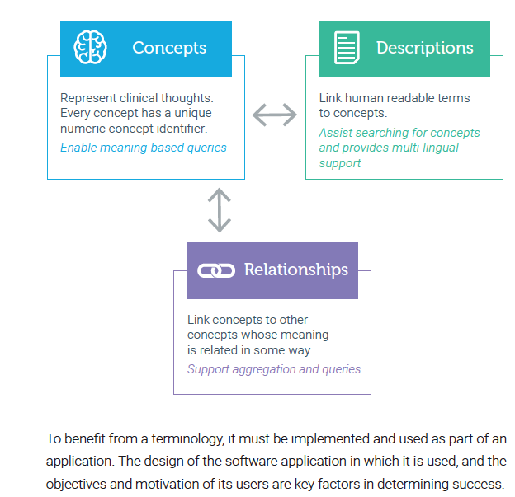
How Does SNOMED CT Work?
SNOMED CT contains concepts with unique meanings and formal logic based definitions.
It is organized into hierarchies and represented using 3 types of components.
Notes:
3 main comonenets
Concepts: These are Clinical Idea’s e.g Fracture of lower Limb. This would have a finding site of Bone Structure of Lower Limb and grouped with an associated morphology of fracture. This idea has a globally unique numeric identifier, which is referred to as the SNOMED CODE.
That Clinical idea can have numerous additional descriptions or synonyms which are often more Human Friendly like Leg Fracture or Fracture of Leg .This could also be an abbreviation, a unique local term like Broken Leg or even a Translation into a local language. These descriptions aids in the search and retrieval of the clinical idea in a variety of ways and can be country specific.
The terminology can also create various relationships (manually and automatically) to identify or enrich the idea, for example SNOMED automatically adds relationships for fractures of every bone in the lower limb, Patella tibia, ankle etc etc. because we have stated that is is a bone structure of the lower limb. The key thing here is that this is an ontology not just an hierarchy so you can infer additional and clinically relevant information that you may not have considered.
Once you done this you can ask SNOMED a million questions to identify and create knowledge from the data. E.g. how many Skiers in Norway have had an open fracture of the ankle or you can just aggregate that up to any fracture of the entire Lower limb. The clinician does not need to add the fracture is an ankle AND is a lower limb fracture, just the ankle. The terminology knows that the ankle is part of the lower limb. And further more you do not need to be concerned that the ankle fracture would get coded to a patients arm…
Putting these three things together leverage the real potential of SNOMED as an ontology to make it useful, retrievable and relevant…its not just a text string.

Slide 7
SNOMED CT Top Hierarchies
Clinical finding － disorders, symptoms/signs
Procedure － surgical procedures, exams, lab tests, nursing care, management procedures
Body structure － systems, tissues, organs
Observable － height, weight, blood pressure
Pharmaceutical/biological products － antibiotics, vitamins, hormones, anesthetics
Specimen － blood, urine, biopsy specimen
Organism － bacteria, virus, animal, plant
Substance － biological/chemical substance, plasma, protein
Environment or geographical location － countries, languages, hospital, department, clinics, community environment

Slide 8
SNOMED CT - purpose
To represent health information
Recorded by all healthcare professionals
  At the level of detail required for current clinical practice
  At point of care
To retrieve and analyze health information
To retrieve clinical statements according to their meaning
  At various levels of abstraction
Supports all healthcare professionals, patient, researchers, organizations, public health, etc. . . .
Meets various healthcare use cases

Slide 9
SNOMED International
Registered in England and Wales | Company Registration Number 9915820
Reg. address: One Kingdom Street | Paddington Central | London W2 6BD | United Kingdom
Tel: +44 (0) 203 755 0974 | info@snomed.org | www.snomed.org
SNOMED International is the trading name of the International Health Terminology Standards Development Organisation
a private company limited by guarantee

