Slide 1
Nursing Clinical Reference Group and external nursing collaborations
17 March 2020

Slide 2
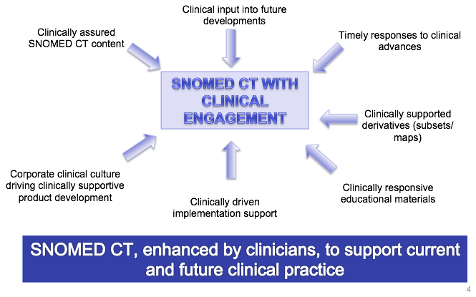
Clinical engagement strategy

Slide 3
Who are our stakeholders ?
Doctors
Allied Health Professionals
Clinical
Educators
Clinical Care Providers
Clinical Colleges
Nurses
Clinical Colleges
Clinical Colleges
Clinical Colleges
Clinical Colleges

Slide 4
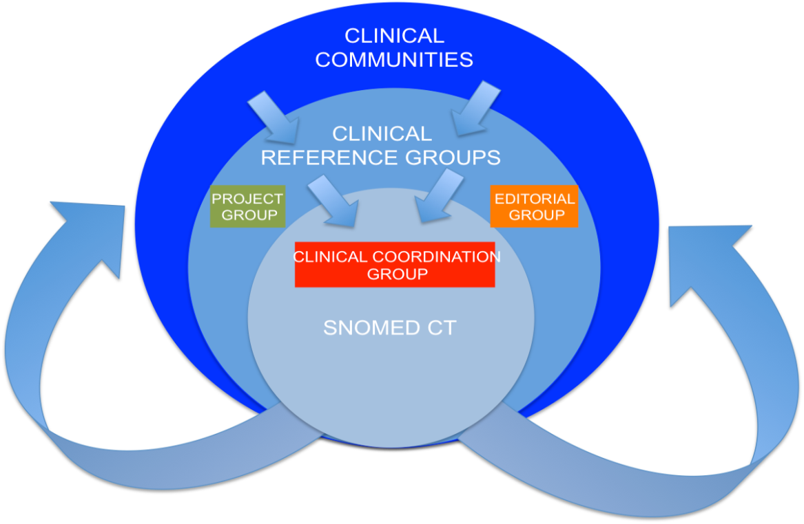
Clinical Reference Groups

Slide 5
Clinical Reference Groups (CRG’s)
Facilitate discussion between clinicians focused on specific clinical specialties or topic areas
Dedicated Confluence sites
The aim is to provide a platform for clinicians to discuss with colleagues any questions, issues and experience relating to SNOMED CT and its implementation.
Open and transparent
Open to all, input not limited to just clinicians from the clinical specialty
Linked to the CRG's are project groups focused on delivering agreed work items and editorial groups (providing clinical validation for derivative products)

Slide 6
Clinical Reference Groups
Whilst CRG's provide the framework, the expectation for the groups is to provide the following:
A framework for multi-disciplinary topic discussion and working across professions, open to all
Access to expertise from all clinical domains
A mechanism for different levels of engagement
Access to discussions on clinical developments by other groups (e.g. implementers), to ensure that products are developed that can be implemented within systems.
Early identification of global changes to healthcare delivery

Slide 7
Clinical Reference Groups and content work
CRGs are established when there is an emerging international requirement identified and a willingness of clinical experts to lead and direct professionally, with terminology support from clinical authors
Linked to the CRG's are project groups (task and finish) focused on delivering work items agreed with SNOMED International with agreed help from SNOMED International
Established database of clinical experts who can help authors with ad-hoc clinical queries

Slide 8













Our Collaborative Partnerships - examples
SNOMED International has an active program of partnership/collaboration with international standards development organizations and professional clinical bodies in order to facilitate the use of SNOMED CT with other international standards.
Notes:
The list of partnerships is steadily increasing as SNOMED adoption continues and this helps use SNOMED data in a number of different ways and improve interoperability and create opportunities for innovation.
SNOMED doesn’t live in isolation and we strive to work closely with these partners to not only develop SNOMED but just as importantly improve their standards.
Only last week we announced our involvement in the Olympic Health Initiative to use advanced digital Health information sharing for the 2020 Tokyo Olympic Games.

Slide 9
Current clinical partnerships/collaboration agreements
Wonca – World Organisation of Family Doctors
ICN – International Council of Nursing
ADA – American Dental Association
AMA – American Medical Association
ERA-EDTA – European Renal Association/European Dialysis and Transplant Association
Working towards formal arrangements with Academy of Nutrition and Dietetics
Working with NANDA-I to add content July 2021 onwards
Other clinical outreach work less formally

Slide 10
Collaboration agreement - ICN
A commitment shared by IHTSDO and ICN to harmonise SNOMED CT and ICNP since at least 2006
A formal agreement put in place in 2010, renewed in 2014, focusing on specific deliverables:
  Nursing Diagnoses
      Alignment of content between ICNP and SNOMED CT where appropriate
      Delivery of an equivalence table
  Nursing Interventions
      Alignment of content between ICNP and SNOMED CT where appropriate
      Delivery of an equivalence table
  Note: ICNP was taken to be the source and SNOMED CT as the target although the goal was towards equivalency
Last updates based on July 2018 SNOMED CT release and ICNP 2017
  Human readable form + joint release notes – ICN
  Electronic files + joint release notes - IHTSDO
Assured by the international community through the Nursing Clinical Reference Group (previously Nursing SIG)

Slide 11

Questions

