Slide 1



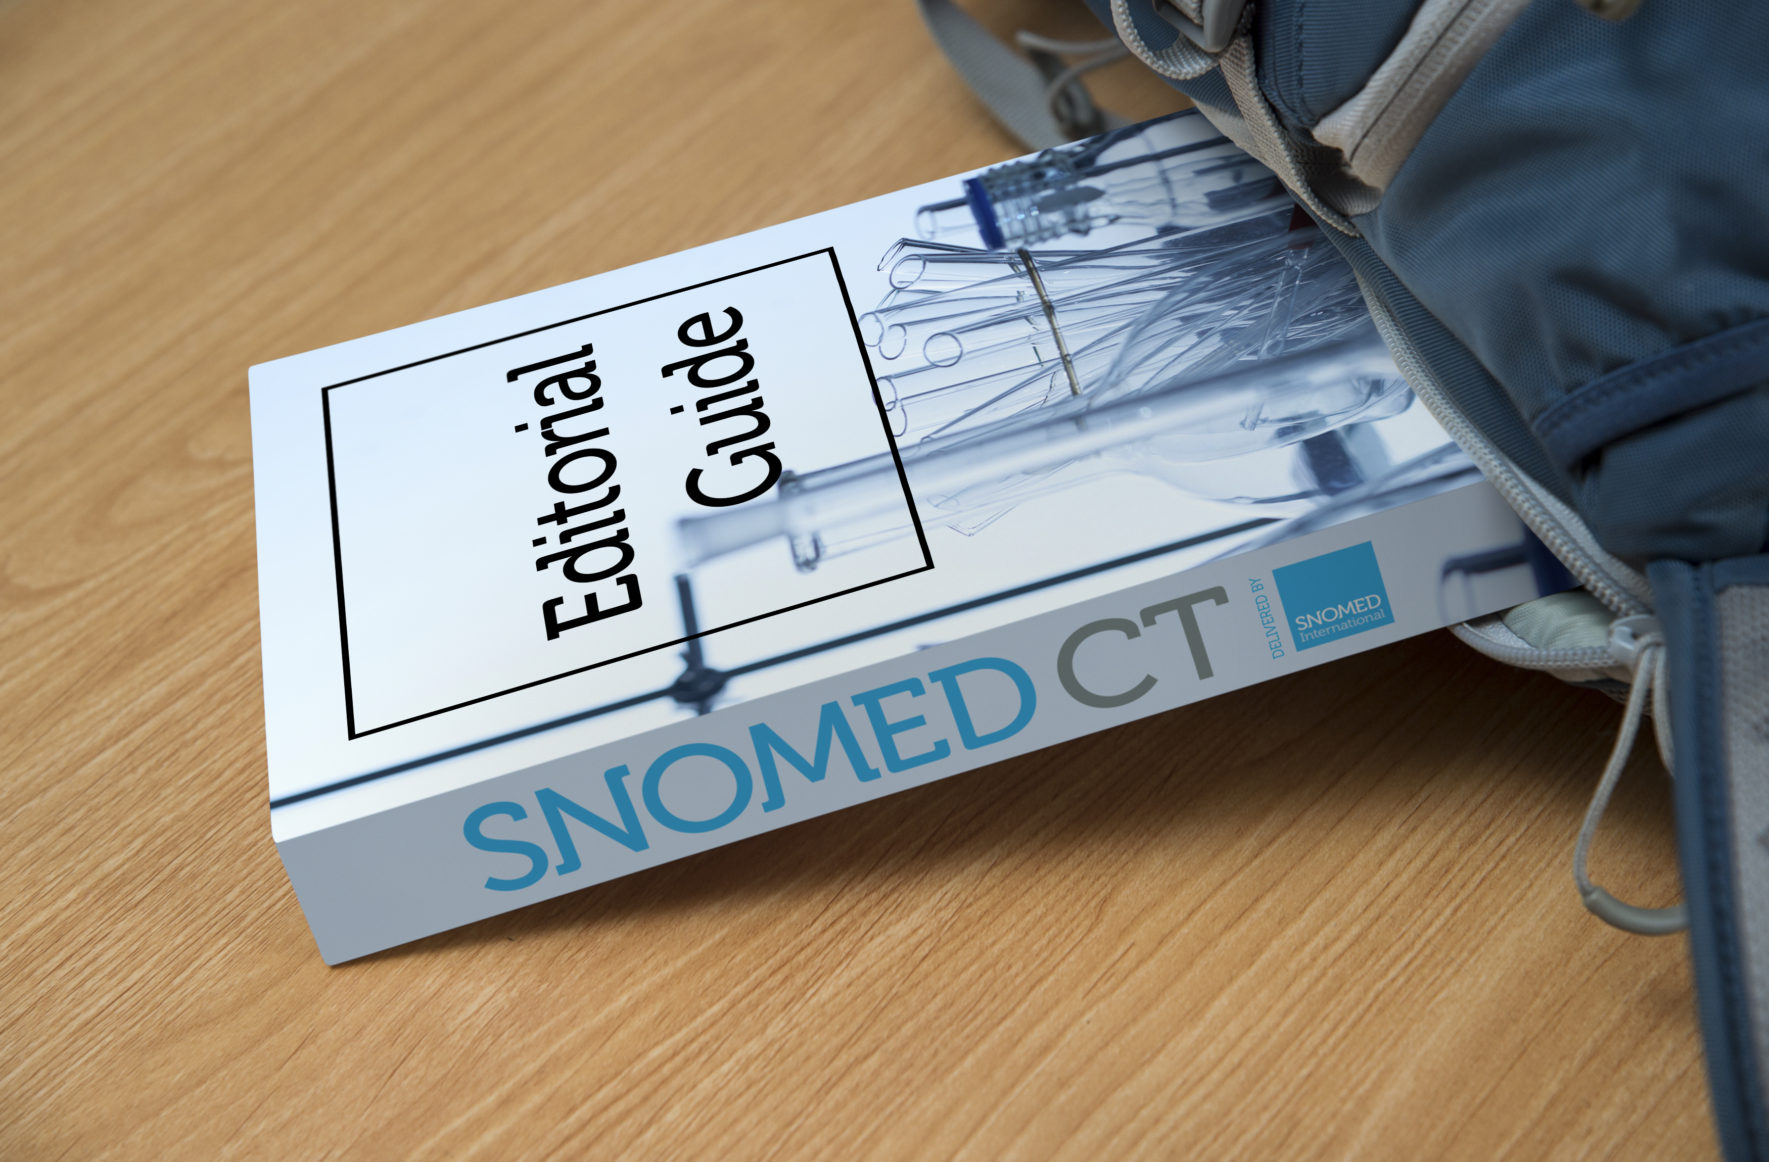
SNOMED CT Course Catalogue
SNOMED CT Foundation Course
SNOMED CT Authoring Level 1 Course & Certification
(Mar & Sep)
SNOMED CT Implementation Course
(Jan & Jul)
SNOMED CT for
Data Analysts
& Developers
https://courses.ihtsdotools.org
Notes:
Our courses teach you SNOMED CT knowledge and skills through online presentations, practical exercises, assignments, tutorials and assessments
Foundation Course – This course provides an introduction to a broad range of SNOMED CT related topics, including the why, what and how of SNOMED CT.
Advanced Courses
Implementation Course – Provides an in depth understanding of the SNOMED CT specific knowledge and skills required to implement a SNOMED CT enabled system. Starts every January and July.
Authoring Level 1 Course – Teaches you the knowledge and skills needed to perform basic SNOMED CT authoring tasks and prepare you for the certification exam. Starts every March and September.
Learning Pathways – Provide a collection of e-learning resources designed to allow students to tailor their learning to their specific needs.
SNOMED CT for Developers
SNOMED CT for Data Analysts

Slide 2

SNOMED CT Foundation Course
Provides an introduction to a broad range of SNOMED CT topics, including the why, what and how
7 hours of presentations and 4 quizzes
Start anytime and complete at own pace
Fees
  Members: FREE
  Non-Members: 400 USD*
* 50% discount for students from middle income countries

Slide 3

Authoring Level 1 Course
Teaches knowledge and skills to perform basic authoring tasks and prepares for certification exam
5 online modules over 5 months
Presentations, webinars, practice exercises, assignments, quizzes
Starts March and September
Fees
  Member: 500 USD*
  Non-Member: 1,000 USD*
* 50% discount for students from middle income countries

Slide 4

Authoring Level 1 Certification
Recognises your competence in performing basic SNOMED CT authoring tasks
Must pass a proctored online certification exam
Exam tests a range of knowledge and skills
Public AL1 certification register available
  http://snomed.org/al1cert
Fees
  Member: 200 USD
  Non-Member: 400 USD

Slide 5
Authoring Level 1 Certification

