Slide 1
Injuries
continued

Slide 2
Proposed injury models
Model for injuries
  Associated morphology = << 37782003 |Damage (morphologic abnormality)|
  Add additional morphologies under 37782003 |Damage (morphologic abnormality)|derived from disorders under ICD-11 chapter 22 Injury, poisoning or certain other consequences of external causes
Model for Traumatic injuries
  Due to 773760007 |Traumatic event (event)|
  Retire traumatic morphologies (<<19130008 |Traumatic abnormality (morphologic abnormality)|)and replace with unspecified morphologies
    Ie. 415747007 |Traumatic rupture (morphologic abnormality)| 125671007 |Rupture (morphologic abnormality)|
Model for Nontraumatic injuries
  Due to 789750003 |Spontaneous event (event)|
  Replace nontraumatic and spontaneous morphologies with unspecified morphologies and move under 37782003 |Damage (morphologic abnormality)|if not already a subtype

Slide 3
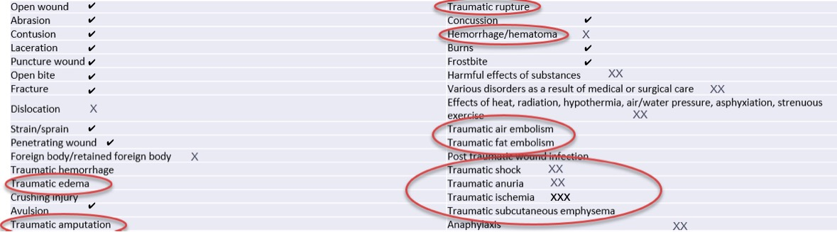
Injuries in ICD-11
X = morphology not a descendant of 37782003 |Damage (morphologic abnormality)|
XX = do not have morpholgies
XXX = 449735000 |Structural change due to ischemia (morphologic abnormality)|
These have morphologies that are descendants of 37782003 |Damage (morphologic abnormality)|
✓

Slide 4
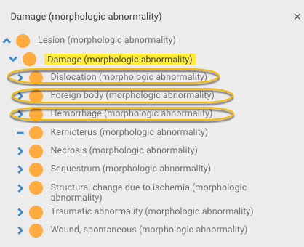
Revised 37782003 |Damage (morphologic abnormality)|hierarchy

Slide 5
ICD-11 traumatic disorders
Traumatic hemorrhage
Traumatic edema
Traumatic amputation
Traumatic rupture
Traumatic air embolism
Traumatic fat embolism
Post traumatic wound infection
Traumatic shock
Traumatic anuria
Traumatic ischemia
Traumatic subcutaneous emphysema
Traumatic in the FSN implies an injury
If traumatic morphologies are inactivated and replaced by unspecified morphologies, the unspecified morphologies may not be regarded as kinds of damage
  e.g. edema, fat embolus, air embolus
Some ICD-11 injury disorders do not have morphologies
  e.g. shock, anuria

Slide 6
Proposals
Retain specific traumatic morphologies that would not be kinds of damage if converted to unspecified morphologies and create new traumatic morphologies as required
OR
For traumatic injuries use 2 role groups, one containing an associated unspecified morphology and the other 37782003 |Damage (morphologic abnormality)|
Can apply similar approaches to nontraumatic injuries

Slide 7
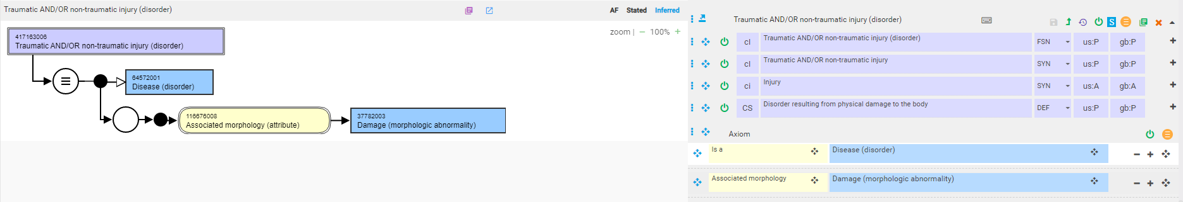
Injury model

Slide 8
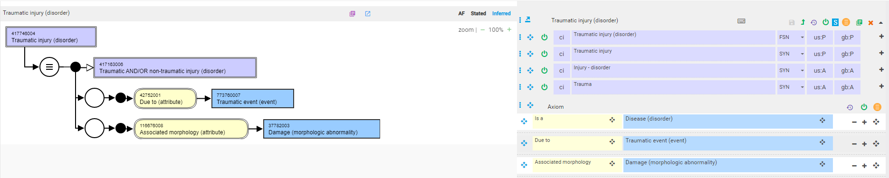
Proposed Traumatic injury model

Slide 9
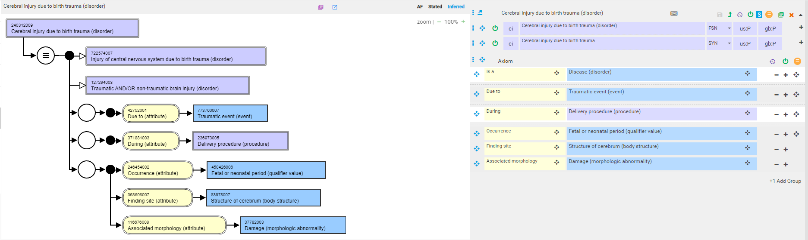
240312009 |Cerebral injury due to birth trauma (disorder)|
Model as currently in daily build browser

Slide 10
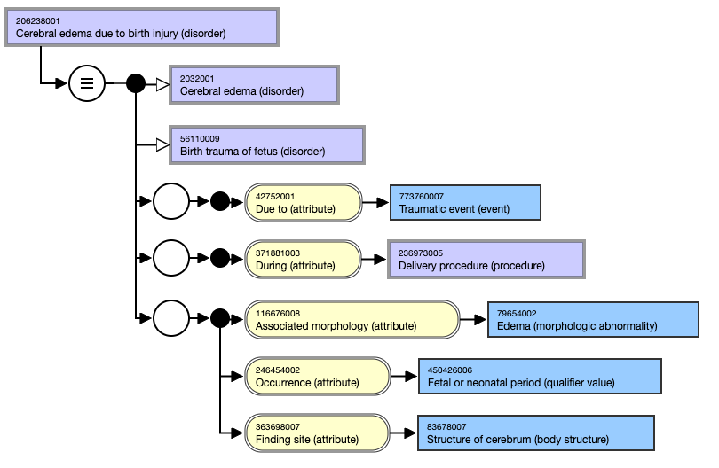
206238001 |Cerebral edema due to birth injury (disorder)|
Model as currently in daily build browser

Slide 11
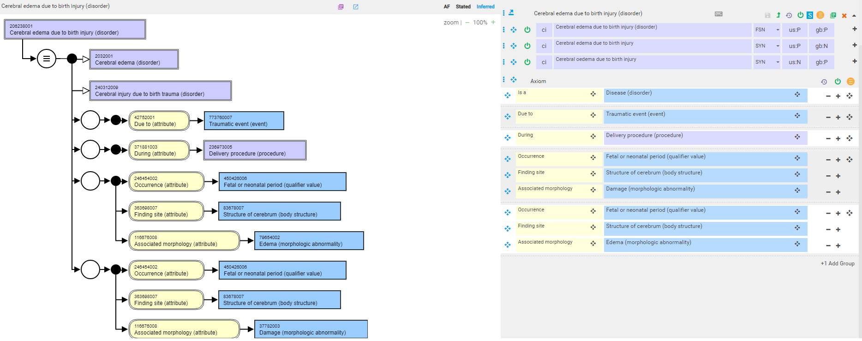
206238001 |Cerebral edema due to birth injury (disorder)| - proposed model using 2 role groups

Slide 12
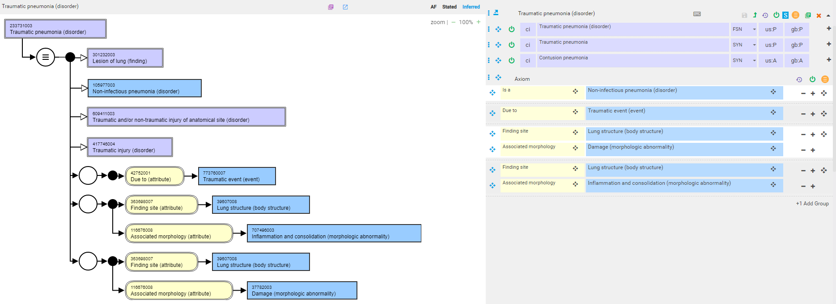
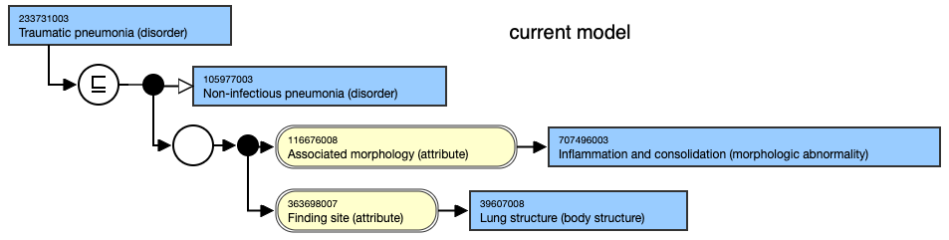
233731003 |Traumatic pneumonia (disorder)|- proposed model

Slide 13
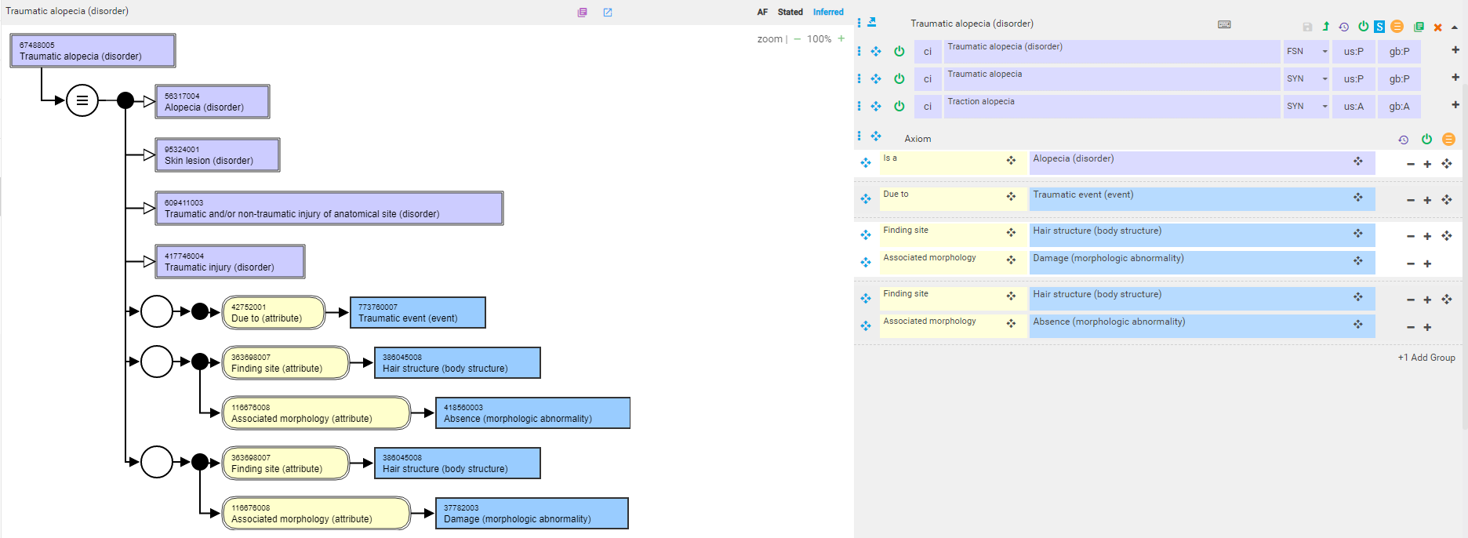
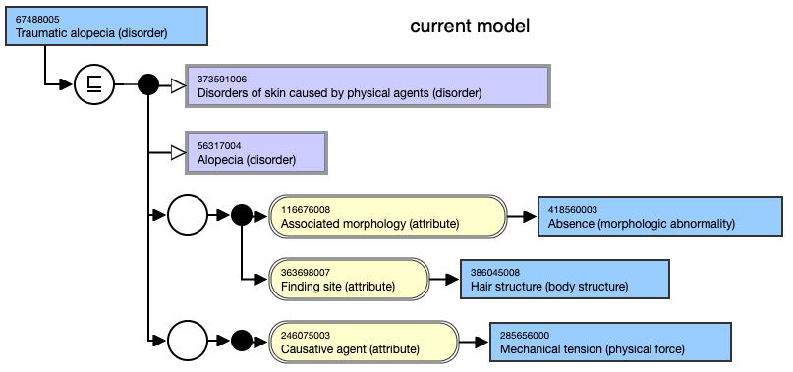
67488005 |Traumatic alopecia (disorder)|- proposed model

Slide 14
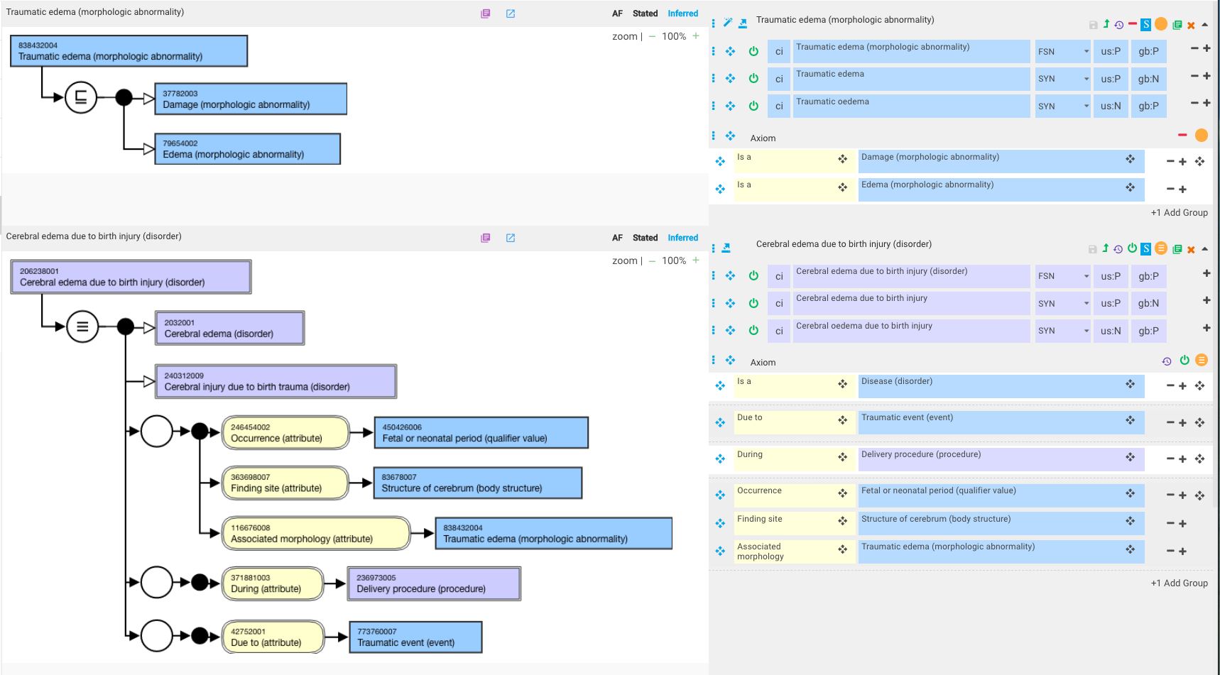
206238001 |Cerebral edema due to birth injury (disorder)| - proposed model using new traumatic morphology

Slide 15
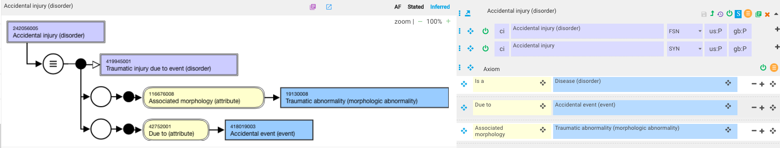
Accidental injuries
159 descendants of 242056005 |Accidental injury (disorder)|
Current model

Slide 16
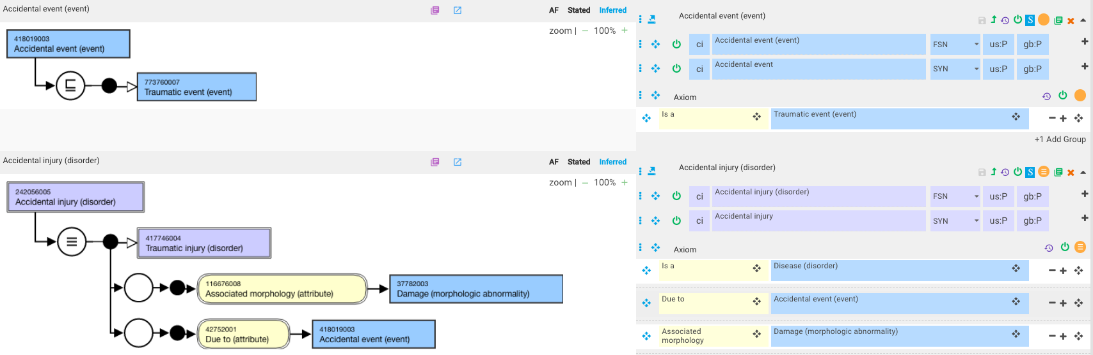
242056005 |Accidental injury (disorder)|

Slide 17
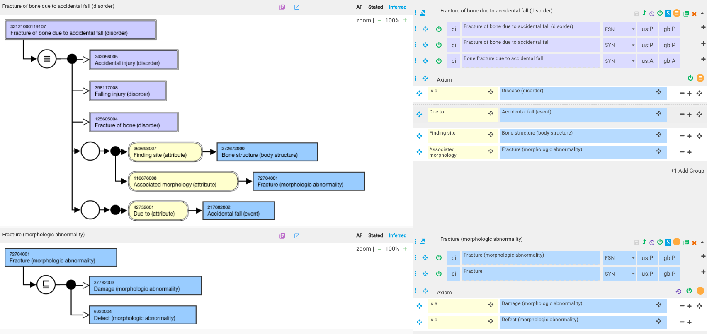
32121000119107 |Fracture of bone due to accidental fall (disorder)|

Slide 18
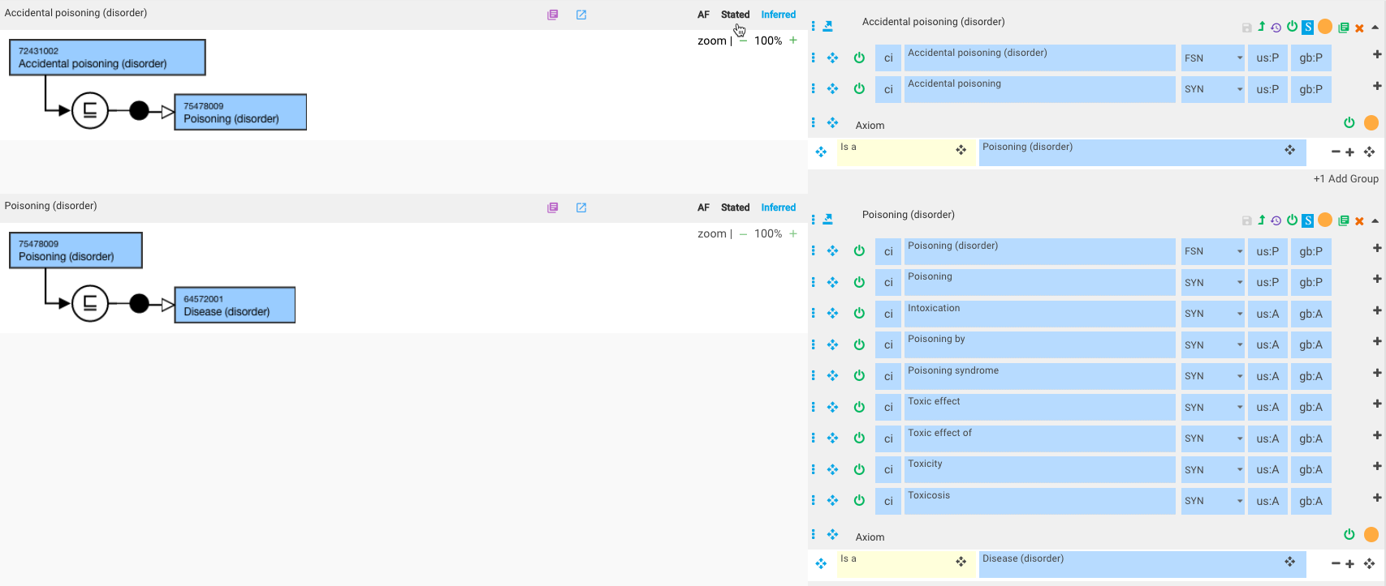
Accidental poisoning
Poisoning and accidental poisoning are not injuries in SNOMED

Slide 19
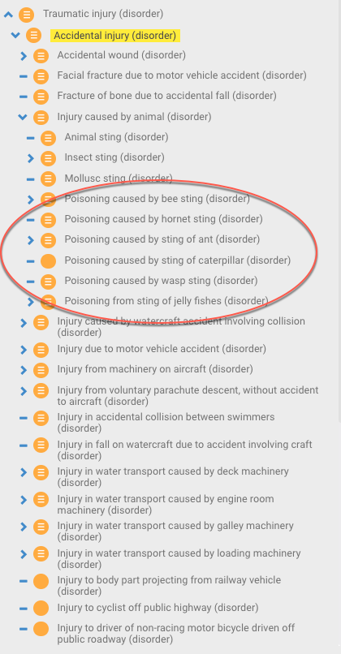
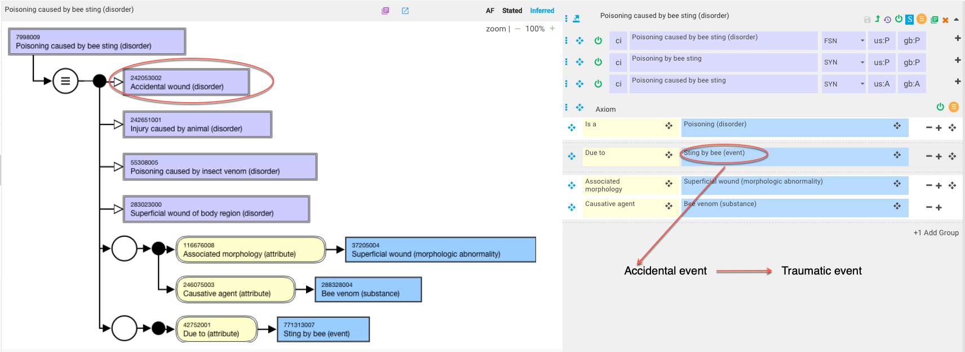
But….
Perhaps “poisoning” is not an optimal for these concepts

