Slide 1
Clinical engagement – CRG Leads call
15 January 2020

Slide 2
Topics for discussion
Introductions
SNOMED International updates
Clinical groups going forward - update
Confluence updates
Agenda for Wednesday 29 January Clinical call – discussion
Preparation for April 2020
  CRG meetings
  Clinical day agenda
Communication and promotion

Slide 3
Clinical engagement next steps – Kuala Lumpur, Oct 2019
Quarterly clinical engagement meetings
  January and June/July – teleconference 2 hours
  April and October business meetings – full day clinical meetings/forums
  Focused on latest news and activities at SNOMED International, presentations from across globe on implementations, analytics, content development etc
Putting together clinical expert reference groups to review specialty areas of SNOMED CT. Task and finish. First one/pilot – Epilepsy
Reaching out to clinical groups to provide education
Presenting at clinical meetings
Identifying more clinical experts willing to be on database of specialists able to deal with adhoc queries raised by SNOMED International authors

Slide 4


Clinical groups going forward - update

Slide 5
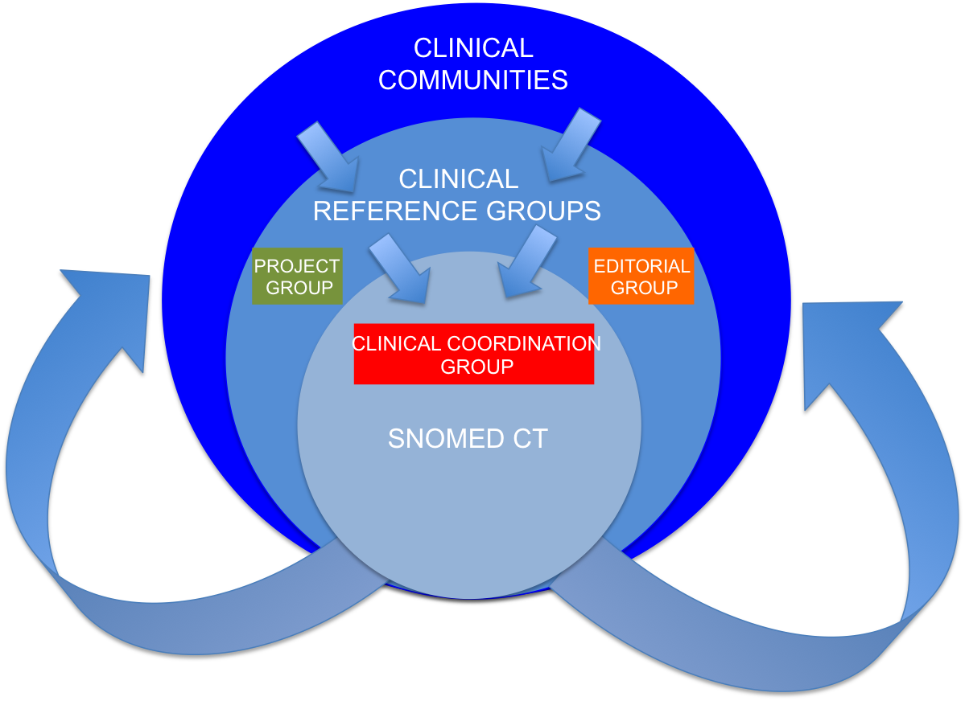
Clinical Reference Groups (CRG’s)

Slide 6
Clinical Reference Groups (CRG’s)
Facilitate discussion between clinicians focused on specific clinical specialties or topic areas
Dedicated Confluence sites
The aim is to provide a platform for clinicians to discuss with colleagues any questions, issues and experience relating to SNOMED CT and its implementation.
Open and transparent
Open to all, input not limited to just clinicians from the clinical specialty
Linked to the CRG's are project groups focused on delivering agreed work items and editorial groups (providing clinical validation for derivative products)

Slide 7
Introduction of Clinical Expert Project Groups
To support review and updating of specialty content in SNOMED CT
  Requirements identified by Content Team
  Requirement identified by a professional group
Global clinical experts
Supported by an Author and on content work plan
Aim to have 2 per year and agreed timelines
Review of content, identification of gaps and advice on modelling
Task and finish, moving to then be a CRG if clinicians feel there is a benefit
Testing with Epilepsy (raised by community)

Slide 8
Confluence updates – Ian Green

Slide 9
Demo
Clinical engagement page
Clinical community
  Conference calls
  SNOMED Conference meetings
Directory of CRGs
Clinical resources and example topics
FAQs
Discussions

Slide 10
Discussion
Further thoughts on developing on line clinical community
Issues and how we can improve things

Slide 11
Clinical Community webinar – Wednesday 29 January

Slide 12
Draft agenda – 29 January 2020
Welcome
Overview of future Clinical Community meetings approach
Introduction to individual CRGs – CRG leads (5 mins)
  Purpose, scope, meeting schedule, attendees etc
  Questions
Clinical education – approach, timelines etc
April 2020 SNOMED International meeting London
  CRGs
  Clinical day details
Input re future calls

Slide 13
Preparation for April 2020 Business meeting, London (5-8 April)

Slide 14
Schedule
CRGs meeting
  Anesthesia
  Dentistry
  Mental and Behavioural Health
  Allergy/Hypersensitivity and Intolerance
  Cancer Synoptic reporting
  Pathology and Laboratory Medicine
SNOMED CT Supporting Clinicians – Wednesday 8 April
https://confluence.ihtsdotools.org/display/FT/April+2020+-+SNOMED+International+Business+Meetings

Slide 15
SNOMED CT Supporting Clinicians – initial thoughts
Updates from SNOMED International
openEHR – using Global Patient Set
Paul Amos – focused work with Diabetes Project Group
Clinical Education – run through
Clinical education – further requirements gathering, discussion
SNOMED CT and clinical research – progress/update

Slide 16
Communication and promotion
Discussion
Increasing clinical community
Be on SNOMED International database of clinicians
Join CRGs
Engaging with professional bodies
Presenting at relevant meetings
etc

Slide 17


Slide 18

Thank
you!
Please contact [NAME | PHONE | EMAIL] for further information.
18

