Slide 1




Real world SNOMED CT
Charles Gutteridge
Clinical Engagement Lead Europe

Slide 2
How humans think and laugh
Horse goes into a bar
Barman says:
Why such a long face?

Slide 3
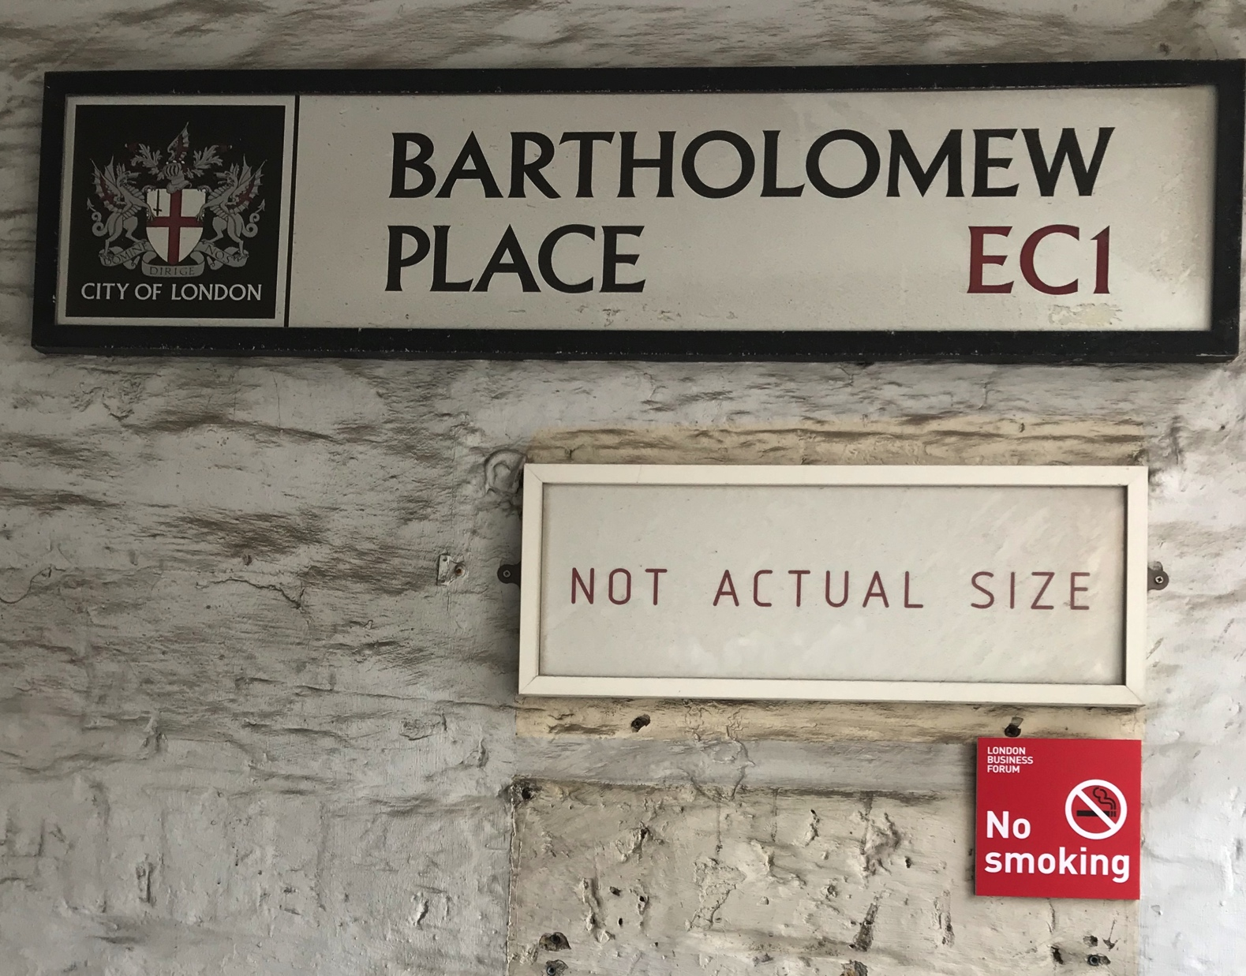
What humans see….and record

Slide 4
Why do we need standardised vocabularies?
Developing actionable insights
Clinical characteristics
Counting
Patient level
Prediction
What will happen to me?
Population health estimation
Can we find a cause?

Slide 5
Starting Practical use of SNOMED CT
Real world examples from Barts Health
SNOMED London April 2019

Slide 6
Practical use of SNOMED Clinical Terms
Clinical overview for point of care
    Problem and diagnosis listing
    Alerts and flags
Population health interventions
    Patient finding
    Indexing
    Analytics and reporting

Slide 7
Data Extraction and Clinician Led Analytics
Timely access to data
Rapid iteration of queries
Self-service analytics

Slide 8
Actionable Analytics
Use of routinely recorded EHR data in real-time to…
  Draw insights about current patient care at whole Trust level
  Develop and implement actions that add value
  Standardise care across the Trust
  Reduce variation across the Trust
What is happening now ?
Where does attention need to be focused today ?

Slide 9
Two Approaches
EHR pop-ups
Seen and actioned by ward based teams
Variability in care
Real-time reports
Seen and actioned by specific teams
Standardisation of care

Slide 10
Infection Control
Problem
Unable to identify patients with infection risk
Unable to ensure these patients are in side rooms
Increased risk of infection transmission and potential increased LoS
Solution
IPC team flag infections + infection status in EHR
Daily report – lists inpatients with active infection + in open bay
IPC team contact relevant wards to ensure these patients are moved
Improvements
Insights are made by central IPC team + actioned in real-time
40% reduction in number of patients inappropriately in open bays
Standardisation of infection control care across Trust

Slide 11
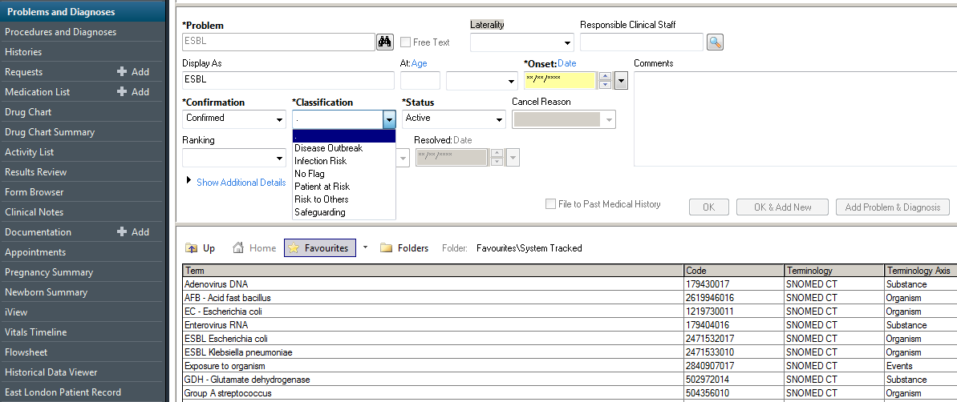
SNOMED
Term
Flagging
Infection
Risk
Status
Selection

Slide 12
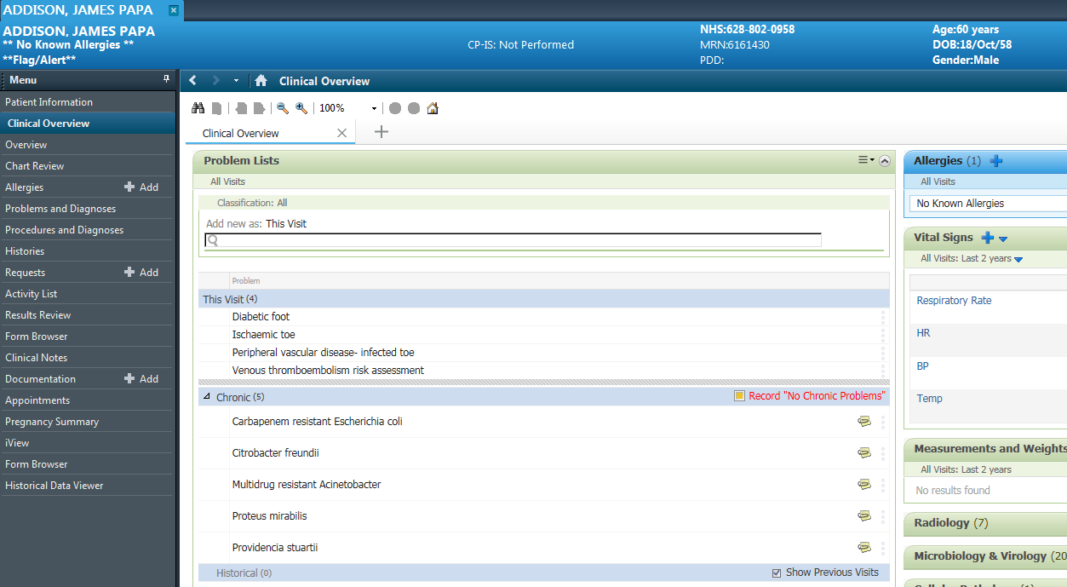
Infection related SNOMED Terms in Problem List

Slide 13
Infection Control
Problem
Unable to report on MRSA screening status of all current inpatients
Unable to take timely correct action for unscreened patients
Increased risk of MRSA transmission and potential increased LoS
Solution
Daily report utilising real-time lab data
Lists all inpatients without MRSA screen 24 hrs post-admission + location
IPC team contact relevant ward and request urgent screening
Improvements
Insights are co-ordinated by central IPC team + actioned in real-time
MRSA screening status of all current inpatients assessed daily
Standardisation of infection control care across Trust

Slide 14
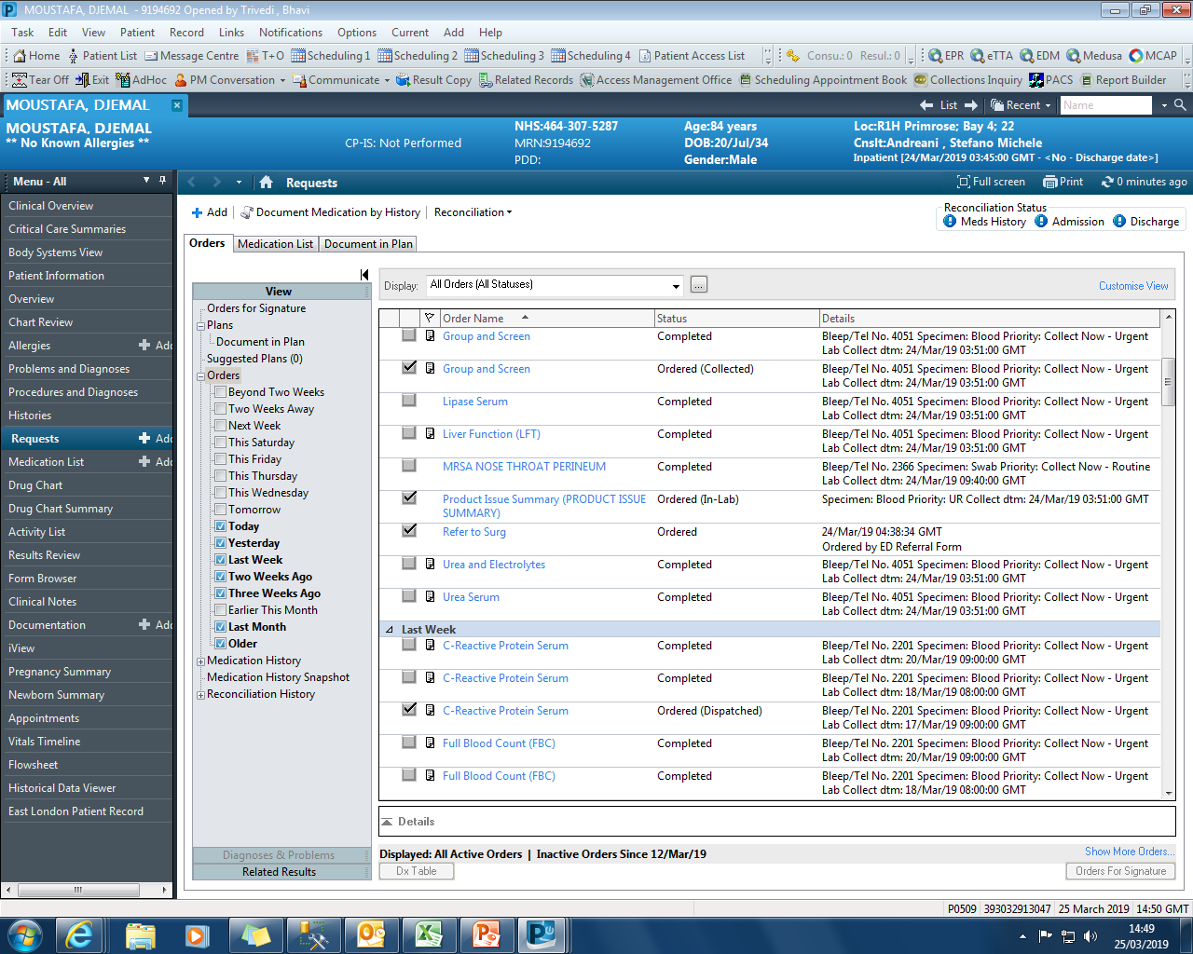

Slide 15
Surgical Site Infections
Problem
Unable to accurately identify at whole Trust level patients with SSIs
Variability in rates of SSIs between teams and within teams
Variability in post-op readmission rates and LoS due to SSIs
Solution
Daily report using routinely entered Surginet data + lab data
Lists post-op patients (last 30 days) + if post-op wound swab ordered
If wound swab +ve, IPC team contact surgical team
Improvements
Insights are co-ordinated by central IPC team + actioned in real-time
Post-op wound swab results reviewed daily and fed back to surgical teams
Standardisation of infection control care across Trust

Slide 16
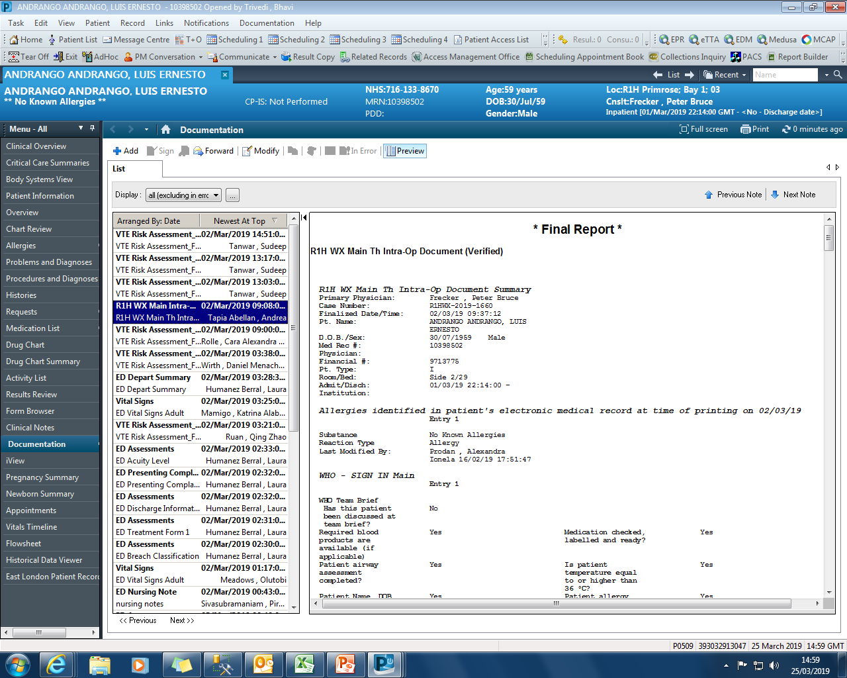

Slide 17
Smoking CQUIN
Problem
Unable to identify in real-time, smoking status for current inpatients
Retrospective reports showed consistently poor performance
Unable to achieve improvements required for CQUIN
Solution
Weekly report run by Public Health team
Lists completeness of smoking status for current inpatients
Direct feedback to poorly performing wards
Improvements
Insights are co-ordinated by Public Health team and actioned in real-time
Improvement in completeness of recording from 5% to 50% in 6 months
Higher rates of referral to smoking cessation

Slide 18
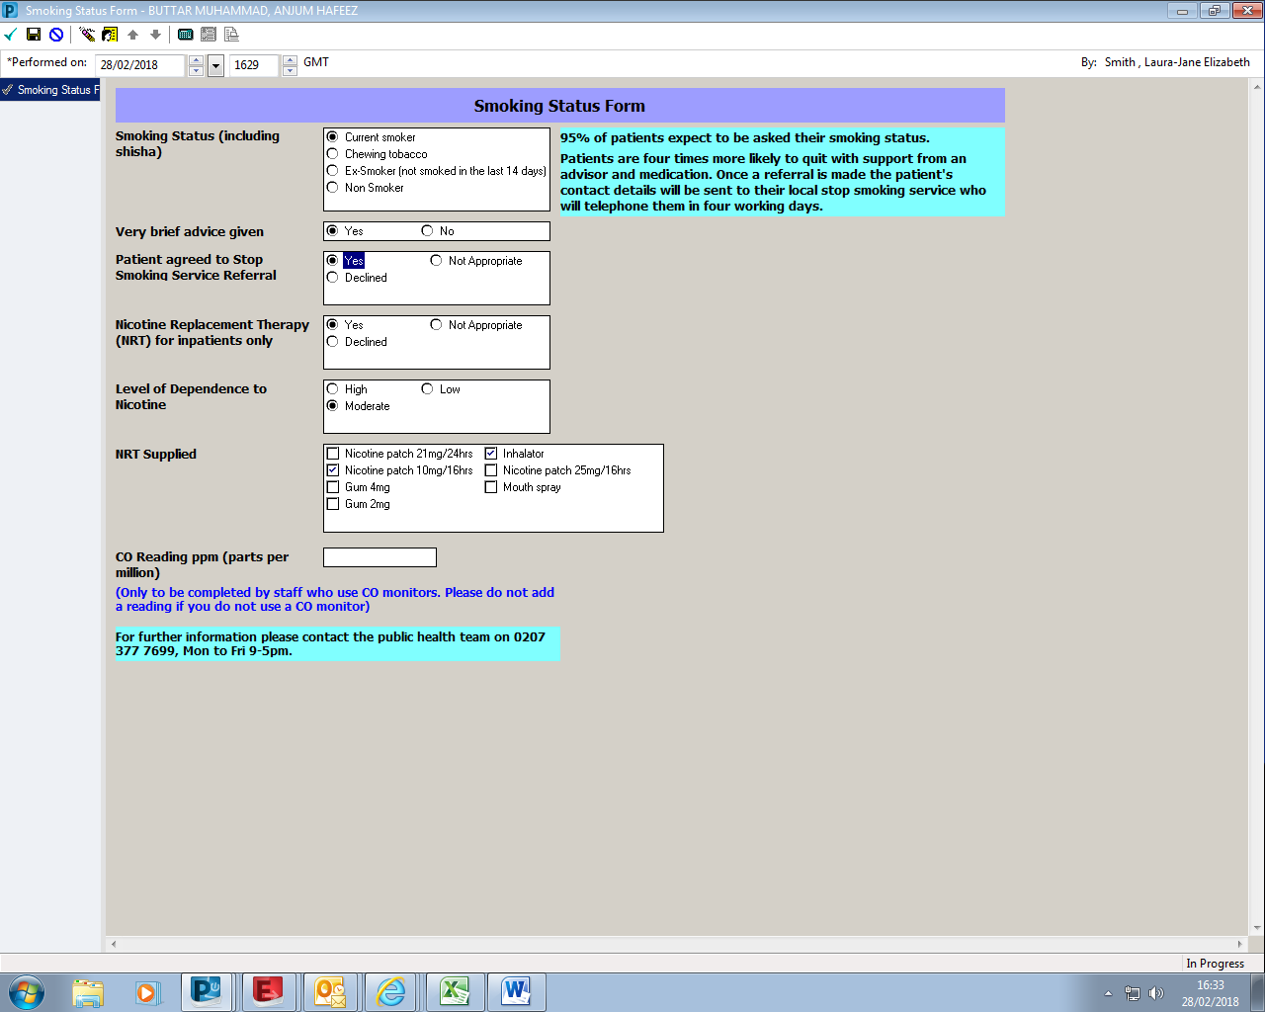
Data Collection
Smoking Status added to the
Problem List
as a
SNOMED Term
Selecting ‘YES’ auto-generates a referral to the Smoking Cessation Clinic
Notes:
A bespoke PowerForm was built to record detail about smoking status
Making smoking status easier to record was the main aim.
We also included chewing tobacco as a smoking status which is of particular relevance to our local population at Barts Health.
Junior doctors are responsible for screening and advising patients about tobacco as part of the clerking process (routine clinical care).
Training was provided to junior doctors so they know how to access the Powerform and the importance of documenting correctly. It is also easy to use and generates automatic referrals to stop smoking services which saves time for them!
Additional feature of the PowerForm is that it has been designed to add the smoking status that is selected to the patient’s problem list, as a SNOMED term.

Slide 19
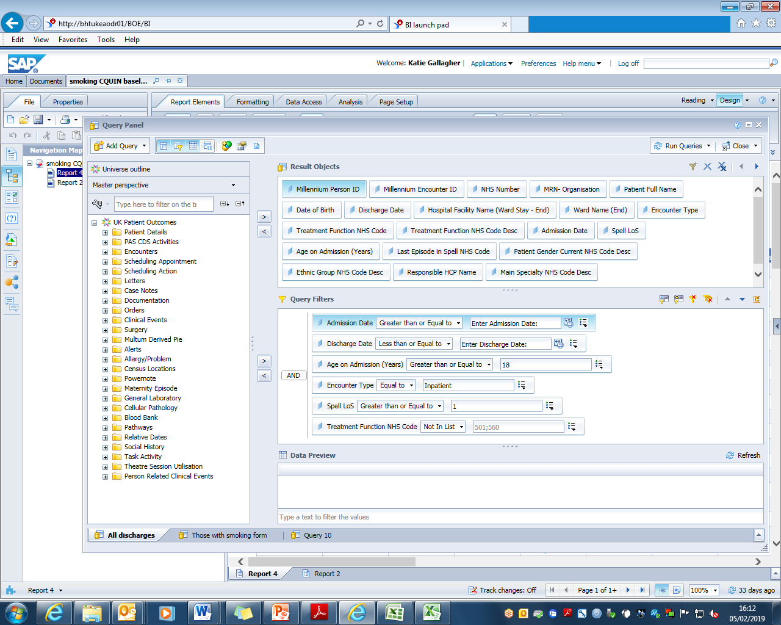
Data Extraction and Utilisation
Notes:
Using the Powerform a report was put together using PowerInsight which details which patients have and have not been screened for tobacco. This can be filtered by site, speciality, ward and consultant. It includes admission dates and length of stay. The data includes all hospital inpatient admissions.
If a Powerform was completed the data shows when it was completed, the patients smoking status (including if they use chewing tobacco), nicotine dependence levels, if brief advice was given, if nicotine replacement therapy was offered, what nicotine replacement therapy products were prescribed and if the patient accepted a referral to a stop smoking service (all of the individual elements from the Powerform).
I was trained to run this report and make basic edits and as a result I can use this for real time reporting. The data is shared with site management teams, wards and specialities.
How is this used? The data can be put into graphs such as the one on the right hand side of the screen. It shows the 4th floor at St Barts hospital, 4E and 4D are the high performing respiratory wards . By presenting this data to other 4th floor wards they are now working together to improve performance as a floor by sharing best practice. You will see an increase in the proportion of inpatients screened for tobacco on the ward.

Slide 20
Learning Disabilities
Problem
Unable to identify in real-time, inpatients with LD at whole Trust level
Unable to identify in real-time, patients with LD at risk of admission
Variability in care and LoS
Solution
LD team add flag to EHR of patients with LD
Daily report - lists current inpatients with LD flag and location
Daily report – lists patients with LD flag discharged from ED yesterday
Improvements
Insights are co-ordinated by central LD team + actioned in real-time
Reduction in time from admission to LD team involvement
Focused admission prevention efforts

Slide 21
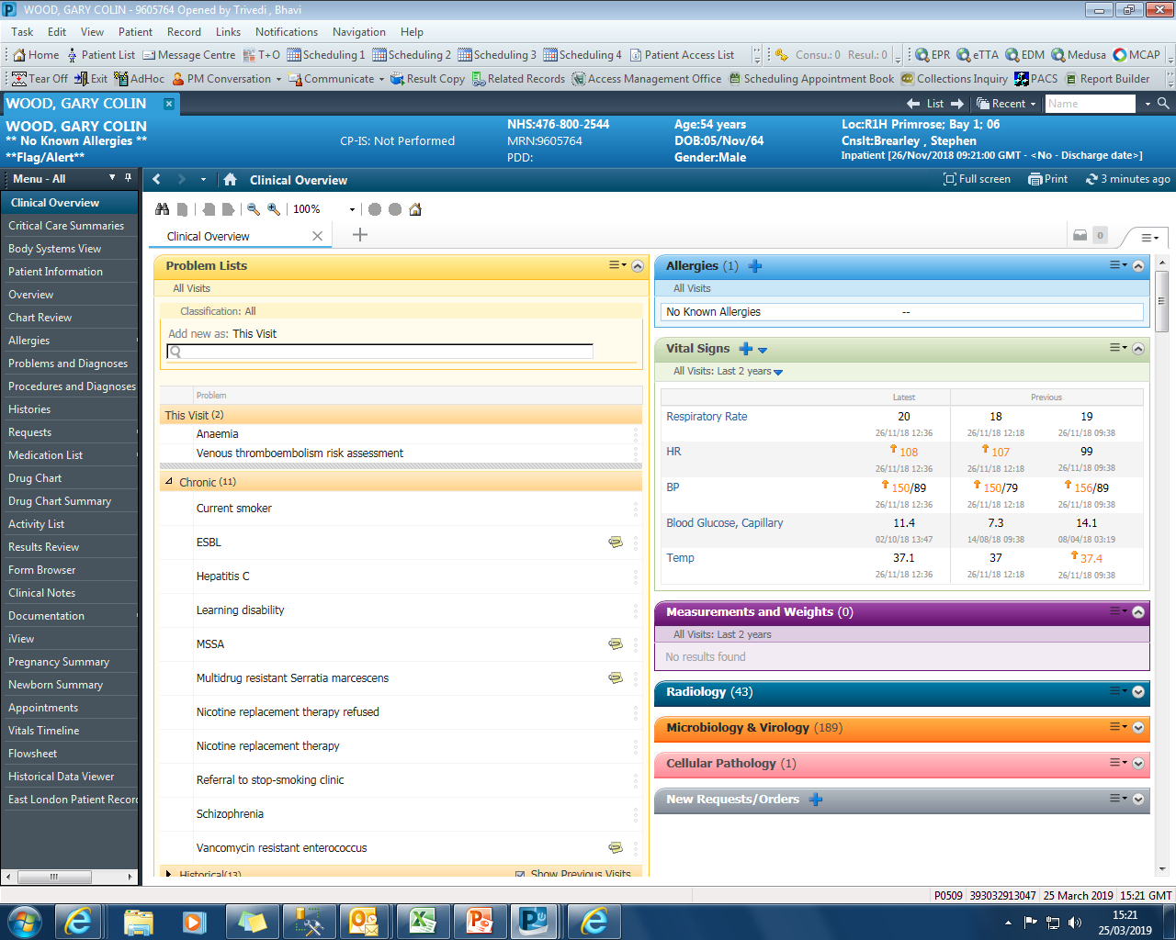

Slide 22
AKI
Problem
AKI alert reported in real time in CRS but variability in time to action
Delays in recognition of AKI increase morbidity, mortality and LoS
Unable to achieve improvements required for CQUIN
Solution
Real-time report to identify all current inpatients with AKI
To be reviewed several times daily by specialist team (?CCOT)
Direct intervention
Improvements
Insights are co-ordinated by central team and actioned in real-time
Reduction in time to recognition of AKI and time to intervention
Standardisation of care for patients with AKI across the Trust

Slide 23
COPD
Problem
High prevalence + common reason for readmission (in top 3)
Unable to collate data to participate in RCP rolling audit
Loss of £1.8m in BPT
Solution
Rolling report created using EHR data for RCP audit submissions
ARCARE team flag (in EHR) patients at high risk of readmission
Daily report lists discharged ‘flagged’ patients - focuses readmission prevention (telephone support and home visits)
Improvements
Pro-active approach to readmission avoidance
Facilitates participation in RCP audit and achieving BPT
Standardisation of COPD care across Trust

Slide 24
The use of PowerChart for Clinical Audit
The Royal College of Physicians
COPD Audit

Slide 25
The proposed solution
Paperless electronic health records (EHR) gradually introduced across all Respiratory Departments within Trust
Key = full use of the EHR to obtain well populated data
RCP data collection for 57 clinical variables
  Only 11 variables cannot currently be obtained from EHR
    Lung Function – results on separate system, not linked to EHR
    Oxygen data incl. prescription, provision, target range
All Respiratory MDT (incl. community team) use Powerchart for documentation
Community team already working with the clinical systems team to collate appropriate SNOMED codes including COPD Discharge Bundle
Use of Powerforms to collate referrals (e.g. to mental health, smoking cessation)

Slide 26
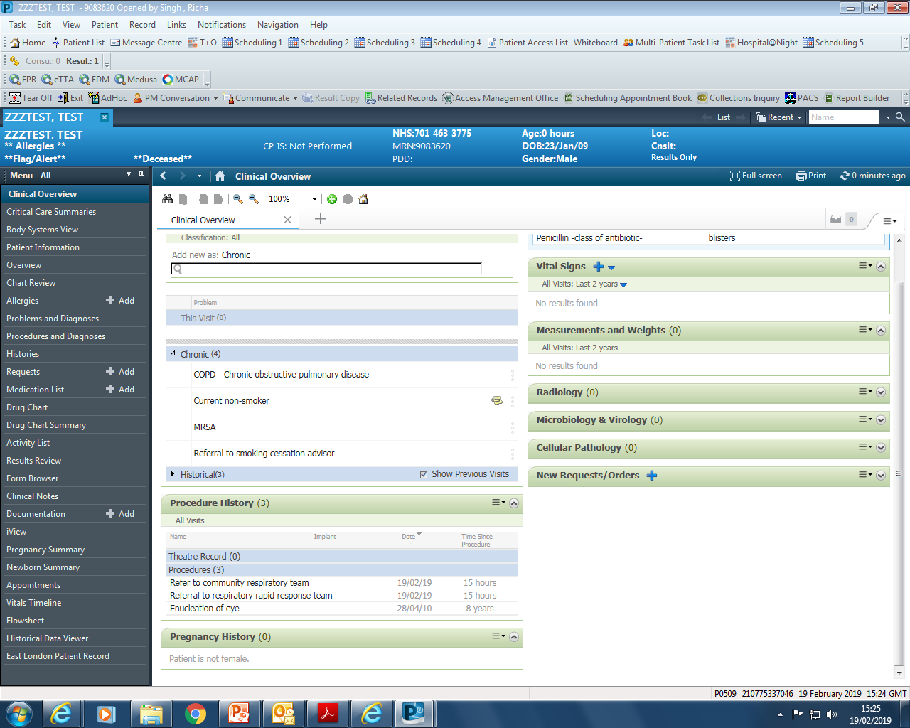
SNOMED Terms for:
Seen by ArCaRe team
&
Early supported discharge
Notes:
Addition of SNOMED codes for the community Resp team incl
Seen by the team
Early Supported discharge

Slide 27
Data Extraction Tool
Majority of information required for clinical audit is already captured through routine patient care
Manually populated Powerchart audit forms duplicate clinical data already captured electronically
Decision made to use Cerner’s data extraction tool to generate data output
Several revisions to report to work around current data gaps where point of care recording by clinicians is poor / incomplete:
  ICD10 codes included to improve capture of Smoking status and Co-morbidities
  OPCS4 codes included to improve capture of Acute NIV use
Output modified to ensure format requirements similar to upload

Slide 28
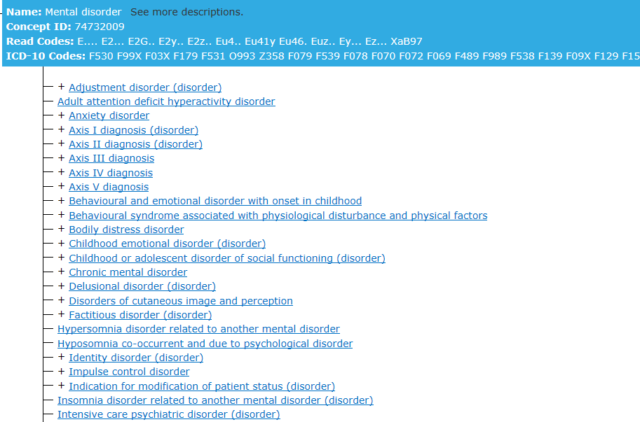
Parent Term
Child Terms
Notes:
Co-morbidities needed to be captured includes mental health disorders, of which there can be many
SNOMED useful for analytics as parent SNOMED term (e.g. mental disorders) can be specified in the data extraction and all child SNOMED terms will be captured.
Avoids having to include long list of individual ICD-10 codes during data extraction and maximises data capture as the terms are entered by clinicians at the point of care (ICD 10 codes are entered by clinical coders). The long list of ICD10 codes that have been entered in the report at present (because our point of care use of SNOMED is not good enough) are listed at the top of the screen shot.
Concept ID = parent SNOMED code
Name: Mental Disorders are all the conditions that are captured

Slide 29
Collaboration
Not only between Respiratory MDT and ICT
Increased education and use of Powerforms
  Public Health (together with CQUIN): improved smoking status, smoking cessation referral and NRT provision recorded
  Critical Care: electronic NEWS2 + oxygen data form (capture missing oxygen data)
  Referrals to other teams e.g. RAID (in-patient mental health services)
  Revision to existing Powerforms to improve clinical data capture
    e.g. COPD Discharge Bundle – include spirometry and date of test; include risk of hypercapnia
Improves patient care, not solely for audit

Slide 30
Current experience
Reproducible method that requires software expertise and time
Enhances structured data recording and move to paperless
Focuses on live service issues
Empowers teams through data ownership
Sustainable data entry and recording
Actionable analytics become part of workflow

Slide 31
Things that matter
Implementation and data presentation
Clinical engagement and practice change
Timely analytics

Slide 32
Sustainability and opportunities
  Develop as part of the clinical informatics service
  Query development requires clinician leader
  QI role reporting to CCIO
  Career opportunities for health professionals
  Development of research quality data from real world use of the EHR
  Training fellowships for postgraduates
  Informatics electives for medical students
What is happening right now ?
Data queries develop as teams
move to paperless

