Slide 1
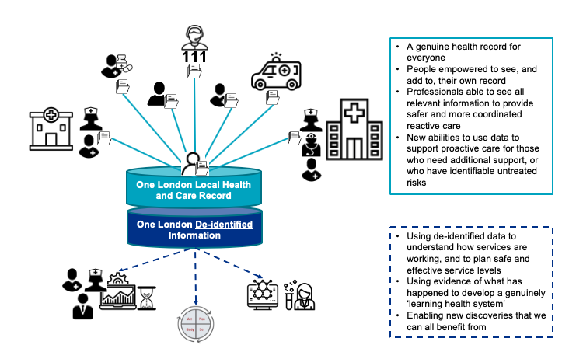
OneLondon (UK)
A partnership of NHS organisations and local government across London. The programme is to align efforts to develop, adopt and use digital technologies, as part of Integrated Care Systems
Notes:
The OneLondon is a partnership of NHS organisations and local government across London. The programme is to align efforts to support care providers in London to develop, adopt and use digital technologies, as part of Integrated Care Systems that deliver proactive population health management; effective new models of planned care; and integrated urgent and emergency care and enable patients.
Have a Strategic Development and Investment Framework that states
Patient and clinical data captured electronically by default
Streamlined clinical and operational process across the organisation and cross system processes
A single view of a patients health and care information at point of care across primary and secondary care
Ability to order and monitor requests for clinical services
Clinical information exchange across the country for specific use case
Public health management using real-time information for analytics/alerts including social care and evidence based interventions.
Patient empowerment through Apps.
Linked data for improved decision making
There are significant benefits to be realised from joining up health and care information, for example, better integration of care, reduced risk of errors and better planning of services to ensure Londoners’ needs are met.
The public has a strong expectation that their information should be available to clinicians at the point of care to support their individual care health and care information may be used for purposes beyond their own individual care, for example, quality improvement, service planning or research.
Electronic shared local health and care record that makes the relevant information about people instantly available to everyone involved in their care and support
The One London model focusses strongly on the delivery of data sharing between providers at the point of care across London to inform and support clinical decision making and inclusive patient access.
Right support in the right place at the right time
We want information, influence and services focused on service users; and we want to use information to create new healthcare knowledge

Slide 2
Discovery Data Service (UK)
Discovery East London program (component of OneLondon) developed the Discovery Data Service (DDS). Data is converted to a common format that is directly compatible with FHIR and SNOMED
Scope
  Used by subscribers of service to access data for direct care or for secondary uses
Why SNOMED CT
  To predict, anticipate or inform individual health needs from algorithms running in real time (or as near as possible) to improve or prevent adverse outcomes.
  To expand the existing primary care informatics driven population health
  To enable the real time reporting on programmes by providers and commissioners supporting clinical improvement
  To use data by third parties (commissioners, public health, and academics) to support research, development and planning,
* DATA INTEGATION
* DATA ANALYTICS
Notes:
Discovery East London is a foundation component of OneLondon.
The Discovery program started with a collaboration of practices in four Clinical Commissioning Groups (CCGs), four NHS trusts, and the sustainability and transformation partnership (STP) covering a population of 1.2 million, and is extending to several other areas.
The Discovery program in East London aims to complement and enhance existing systems (not replace) across the East London Health and Care Partnership. The Discovery Data Service (DDS) has been developed as part of the Discovery program in East London and has four main aims:
・To predict, anticipate or inform individual health needs from algorithms running in real time (or as near as possible) and to deliver the insight gained directly into the patient’s record across the whole of their pathway, whether in primary or secondary care or elsewhere, thus creating the opportunity to improve or prevent adverse outcomes.
・To expand the existing primary care informatics driven population health programme in east London, led by the Clinical Effectiveness Group (CEG) at Queen Mary University of London, to all health and care sectors.
・To enable the real time reporting on programmes by providers and commissioners supporting clinical improvement and new payment mechanisms. This would involve reporting on a depersonalised or identifiable cut of the clinical data, as appropriate.
・To use data by third parties (commissioners, public health, and academics) to support research, development and planning, whether on consented identifiable data, or the depersonalised dataset. East London would thus become a research-enabled community.
Statement from Israel visit David Staples slides on Discovery – Role of SNOMED CT
SNOMED CT (Uses OWL) is a: Necessary but insufficient precursor to achieving the objective
A foothill, not a summit

Slide 3
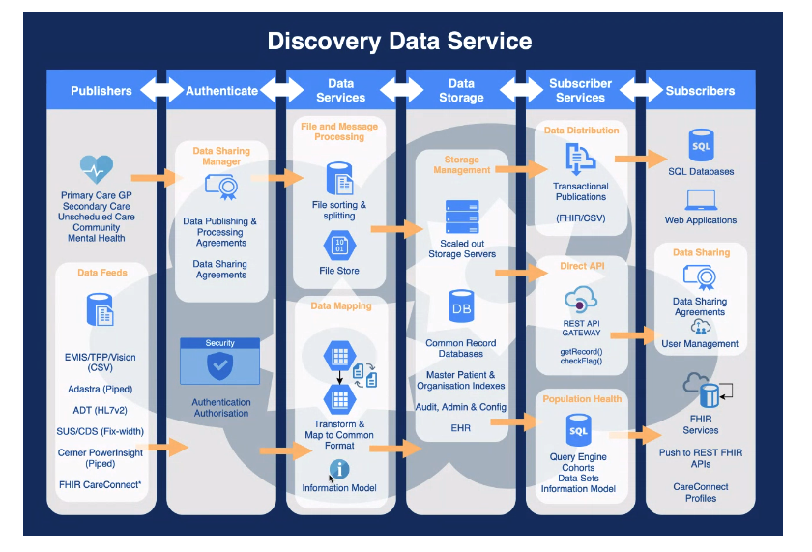
Discovery Data Service (UK)
Notes:
The DDS uses a publish and subscribe model.
・Publishers are health provider organisations who control their data and agree to publish their data once, in a way that can be accessed by many subscribers (the data is either sent automatically or transmitted on request by the service).
・Regionally based data sharing agreements match a number of publishers to one or more subscribers for particular pre-agreed purposes.
・Subscribers are health care organisations who express an interest in accessing a subset of data for a particular purpose.
Only systems can interact with the data service; users do not directly interact with the service and can only obtain data through the system(s) of their choice.
・The data is then converted to a common format that is directly compatible with FHIR and SNOMED CT.
・Depending on the data sharing rules, prior to transmission, the service links the data at a patient level by NHS number. A subset of the data, for example a cohort of patients, is then made available to subscriber systems. Data is provided either in an identifiable form for direct care, or is de-identified for secondary uses, depending on the agreement.

Slide 4
City Hospitals Sunderland (UK)
City Hospitals Sunderland provides hospital services to a local community along with a range of more specialist services. Uses a Disabilities Terminology Set (DTS) subset of SNOMED.
Scope
  Used by clinicians to encode multifaceted health conditions, technology dependencies, and family‐reported issues of disabled children and their families at point of care – holistic approach
  Used to conduct retrospective analysis
Why SNOMED CT
Improved breadth of data recorded allowing analysis at different levels of detail and supported multiple clinical publications
Analysis of data allowed service provision improvements
e.g. Supporting business cases for additional disability paediatricians and therapists, Improved care pathways and equipment provision
* CLINICAL INTERFACE TERMINOLOGY
* DATA STORAGE
* DATA ANALYTICS
Notes:
City Hospitals Sunderland provides hospital services to a local community of around 350,000 along with a range of more specialist services to a population as great as 860,000. The specialist paediatric disability service provides health care across all settings including the paediatric emergency department, inpatient wards, out-patient clinics, outreach clinics in special schools, and care at home including end of life care.
Issue: There is vast variation in outcomes for disabled children. There is no national data about who or where disabled children are in the UK or what their multi-faceted needs are.
Action: Using SNOMED CT, a Disabilities Terminology Set (DTS) subset was created. Designed to embrace the range of needs experienced by disabled children and their families at different stages of their care journeys, so that these could be accurately recorded.
A traffic light tool (a form) was designed to capture and prioritise needs. Families complete this in the waiting room and bring it to the consultation, which ensures that the needs that matter most to the family that day are addressed.
Data captured by the tool can be recorded in the electronic patient record by the clinician at the end of the consultation.
Benefits of Using SNOMED CT
More than just health conditions can be recorded e.g. body structure, function, activities, participation, personal and environmental factors, technology dependencies, need (or not) for round the clock care etc.
Different levels of detail relevant to the stage in the clinical journey can be captured. For example, at the first visit, ‘impaired social interaction’ may be recorded, then once the assessment is completed, ‘autism spectrum disorder’ may be recorded. This allows analyses at different levels.
Benefits for the patient
The approach facilitates person-centred care by empowering the child and family to raise the issues that matter most to them, so that these can be addressed by the clinician and multidisciplinary team. This leads to improved outcomes, as needs that are properly identified in a timely way can be addressed promptly, with less risk of complications.
The outcome facilitates quantification of complexity of needs, by articulating what they all are. This improves the quality of communication with the interagency team across health, education and social care.
Analysis of data allowed service provision improvements
Supporting business cases for additional disability paediatricians and therapists
Improvements in service design and development
Improved care pathways and secondary uses
Improved equipment provision
Clinical care improvements including prompting clinicians to consider further tests
National Changes
DTS and an associated complexity scale are now the basis of a community healthcare currency model that forms part of a wider programme to establish new approaches to payment for community services (outcome-based commissioning).
Use of DTS subset extended to a national pilot
Population data concerning disabled children and young people are necessary to articulate
their multifaceted needs clearly
plan services
measure outcomes and quantify conditions
understand and describe trends
nequalities
gaps in service provision
contribute to appropriate commissioning of quality services.
Pilots were conducted in 16 hospital and community clinics across UK
The paediatricians who participated in the pilots are enthusiastic about the potential value of the outputs and have already made use of data generated locally
Reference
https://hscic.kahootz.com/gf2.ti/f/762498/39521637.1/PDF/-/Case_Study_Sunderland_SNOMED_CT_201807_V1.0.pdf
https://onlinelibrary.wiley.com/doi/full/10.1111/dmcn.13101
https://www.ncbi.nlm.nih.gov/pubmed/27009933

Slide 5
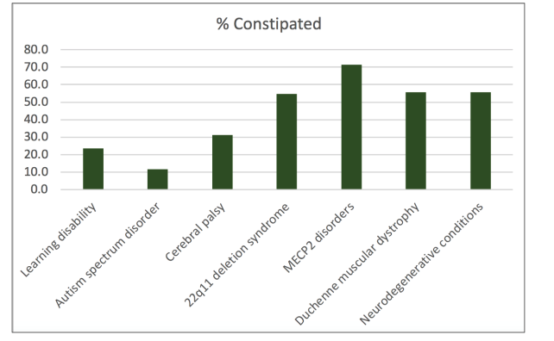
City Hospitals Sunderland (UK)
Power of data
Could the % of constipation be reduced by changes in interventions ?
Notes:
The case study at Sunderland highlighted many data outputs
In the following simple analysis of children and young people – it shows something as simple as constipation is very prevalent in the patient groups and brings up the question “Could the % of constipation be reduced by changes in interventions ?”
The power of analysis can and will improve patient outcomes
References
https://hscic.kahootz.com/gf2.ti/f/762498/39521637.1/PDF/-/Case_Study_Sunderland_SNOMED_CT_201807_V1.0.pdf
https://onlinelibrary.wiley.com/doi/full/10.1111/dmcn.13101
https://www.ncbi.nlm.nih.gov/pubmed/27009933

Slide 6
Medical Informatics Initiative (Germany)
Medical Informatics Initiative between consortiums of multiple university hospitals, additional partners such as research and higher education institutions, businesses, and non-university hospitals
Scope
  To use SNOMED CT for data integration in data integration centres so doctor, patients and researcher have access to information they require
  May use SNOMED CT to code patient care
Why SNOMED CT
  Translate different medical terms into an internationally standardized numerical code
  Strengthen research and enhance patient care
  Innovative IT solutions for specific medical applications
* DATA INTEGATION
* DATA ANALYTICS
Notes:
The Medical Informatics Initiative was created to close the gap between research and healthcare
Involves consortiums of multiple university hospitals, additional partners such as research and higher education institutions, businesses, and non-university hospitals to create a framework that harnesses research findings to the direct benefit of patients.
Central vision of the initiative is the development and deployment of IT solutions to strengthen research and enhance patient care in university hospitals
MII participants nationwide have a license to use SNOMED CT
To date, there is no binding Germany-wide standardisation apart from codes for diagnoses and treatment procedures employed for health insurance invoicing and accounting
In the initiative’s first phase, university hospitals and partner organisations will establish and link data integration centres (per consortia).
Ensure the interoperability of IT systems and data integration centres between the consortia
These centres will allow research and healthcare data to be aggregated and integrated across multiple entities and sites.
At the same time, innovative IT solutions for specific medical applications will be developed to demonstrate the benefits of high-tech digital healthcare services and infrastructures.
Why is SNOMED CT provided in this way and at this time?
Want and need to use SNOMED CT for its data integration
The MII and the university hospitals participating in it have offered to pilot SNOMED CT and to prepare for the possible use of SNOMED CT throughout Germany, also in patient care.
The preparatory work on the core data record and its cross-location exchange via HL7 FHIR is already well underway
With the help of SNOMED CT, programs can translate different medical terms into an internationally standardized numerical code.
In this way, clinical data from different countries can be compared and used for research. This creates the prerequisites for treating diseases more effectively in the future, recognizing them faster and supporting prevention. The networking of routine care data and top medical research has great potential - for better medical treatment and for strengthening Germany as a business and science location.
The use of SNOMED CT® as an internationally connectable basic nomenclature opens up the possibility of annotating medical content across systems and sectors and, on the other hand, of using the captured content in the long term both for research tasks and for the development of AI-based medical support instruments. The use of the SNOMED CT® codes is linked to the medical information in the background.
Reference
https://www.medizininformatik-initiative.de/de/snomed-ct-haeufig-gestellte-fragen
MII Core Data Set THIS DOCUMENT WAS WRITTEN IN MARCH 2017 – so may not have been updated
https://www.medizininformatik-initiative.de/sites/default/files/inline-files/MII_04_Core_Data_Set_1-0.pdf
All university hospitals have agreed on a shared core data set to be maintained as a minimum for all relevant patient data – irrespective of indication and of the research consortium’s defined use case. This entails not just defined requirements for the scope of data, but also with regard to standardisation of medical content in line with international standards.
Diagnoses
In the MII core data set, the structuring and coding of a “Diagnoses” table as a sub-table of the “Case”
table (Visit_occurrence) can for the most part be based on the “ICD” table in the inpatient Sec21-data set.
Coding in accordance with SNOMET CT should supplement the ICD coding (internationalization) in short order
Procedures
A “Procedures” table (“Procedure_occurrence”) analogous to the “OPS” table of the Sec21-data set should
be planned in the DIC starting phase. Coordinated adjustments can be made as needed. Overlaps and the
differentiation of procedures and medications should be reviewed in short order.

Slide 7
Rotherham NHS Foundation Trust (UK)
Rotherham NHS Trust is a modern, progressive trust, with a focus on supporting the local district
Scope
  Used by clinicians to record both SNOMED CT procedure and diagnosis using in-house designed SNOMED CT subsets
  Used to support KP’s disease management programs
Why SNOMED CT
  Improved speed of data entry, standardisation and data quality
  Improved efficiencies as SNOMED CT used for better discharge summaries, national data set reporting and automatic generation of classification codes
  Better support for clinical audit, trend analysis, freedom of information requests and data quality through data analysis
  Real-time clinical dashboard - SNOMED CT has enabled a longitudinal record to be visible as well as a more holistic view of the patient
  Procedure subsets enabled better monitoring and scheduling
* CLINICAL INTERFACE TERMINOLOGY
* DATA STORAGE
* INDEXING SYSTEM
DATA ANALYTICS
MAPPING TO CLINICAL CODES
* COMMON LANGUAGE
Notes:
Rotherham NHS Trust is a modern, progressive trust, with a focus on supporting the local district. The accident and emergency (A&E) department deals with around 75,000 patients per year and there are approximately 55,000 in-patient and 250,000 out-patient attendances each year.
WHY:
Implement the national objectives of collecting data once, at point of care, to support clinical needs and facilitating other process from that data
Requirement to improve the efficiency of the clinical coding to ICD10 and OPCS-4 from the clinical terms, as well as have improved visibility of their out-patient activity.
HOW:
They worked closely with their chosen supplier to adapt the existing supplier product (Meditech) to utilise SNOMED CT. The new system utilises SNOMED CT for both procedure and diagnosis recording with SNOMED CT terms presented to the clinical staff for data entry.
In-house SNOMED CT subset creation (pre-defined lists that were approved by the clinicians in each specialty) was focused on clinical ownership of the content in the patient record, and for that content to be of quality (completeness, level of detail and accuracy)
The reason for restricting data entry was to improve the speed of data entry, recording standardisation and assured data quality
60 subsets; one diagnoses subset and rest subsets relating to the different specialties’ procedures – each being available in the different clinical settings and selected by the system when a user logs into a particular clinic.
Procedure subsets used for scheduling and resource allocation
When a patient is listed for a procedure the clinician: Decides where they would like to carry out the procedure, e.g. theatre, day-case unit or special clinic, which in turn selects the correct subset. They then select the appropriate clinical term from that subset. These two pieces of information are then used to book resources in the appropriate location.
Diagnoses subset (65,000 concepts).
The preferred term is displayed as the default description and the system allows only one description to be used as a default description for each concept
The search can be performed on all SNOMED CT descriptions
Benefits
improved the speed of data entry, standardisation of recording, improved data quality and subsequent analysis.
Improved efficiencies as SNOMED CT entered terms can be used for national data set reporting and automatic generation of classification codes
Better support for clinical audit and data quality through data analysis and identifying particular cases
More accurate trend analysis, and thus improved planning and commissioning
Procedure subsets enabled better monitoring of theatre usage and resources
Real-time Clinical Dashboard - SNOMED CT has enabled a longitudinal record to be visible as well as a more holistic view of the patient
Freedom of Information (FOI) requests - now be dealt with more quickly and accurately by analysis of SNOMED CT data.
Improved visualisation of activity - Improved visibility of the clinical outpatient activity leads to much better patient care. The Trust cut outpatient waiting lists by 65% in some areas, as well as recorded a drop in the number of missed appointments (DNAs) per month.
Discharge Summaries - Discharge summary is massively improved with a better level of information. This is beneficial to both GP’s and patients.

