Slide 1
COVID and Cancer – The use of real time data and open standards
Monica Jones
Chief Data Officer – DATA-CAN
Associate Director – HDRUK North
Executive Lead - YHCR Population Health

Slide 2
Agenda
Background to HDRUK Hubs and DATA-CAN
The need for linked, longitudinal records, shared care records e.g. Yorkshire and Humber Care Record (YHCR)
COVID and impact on NHS cancer services and outcomes
Use of real time data, clinical terminologies i.e. SNOMED CT and open standards
Plans for the future
Questions and answers

Slide 3
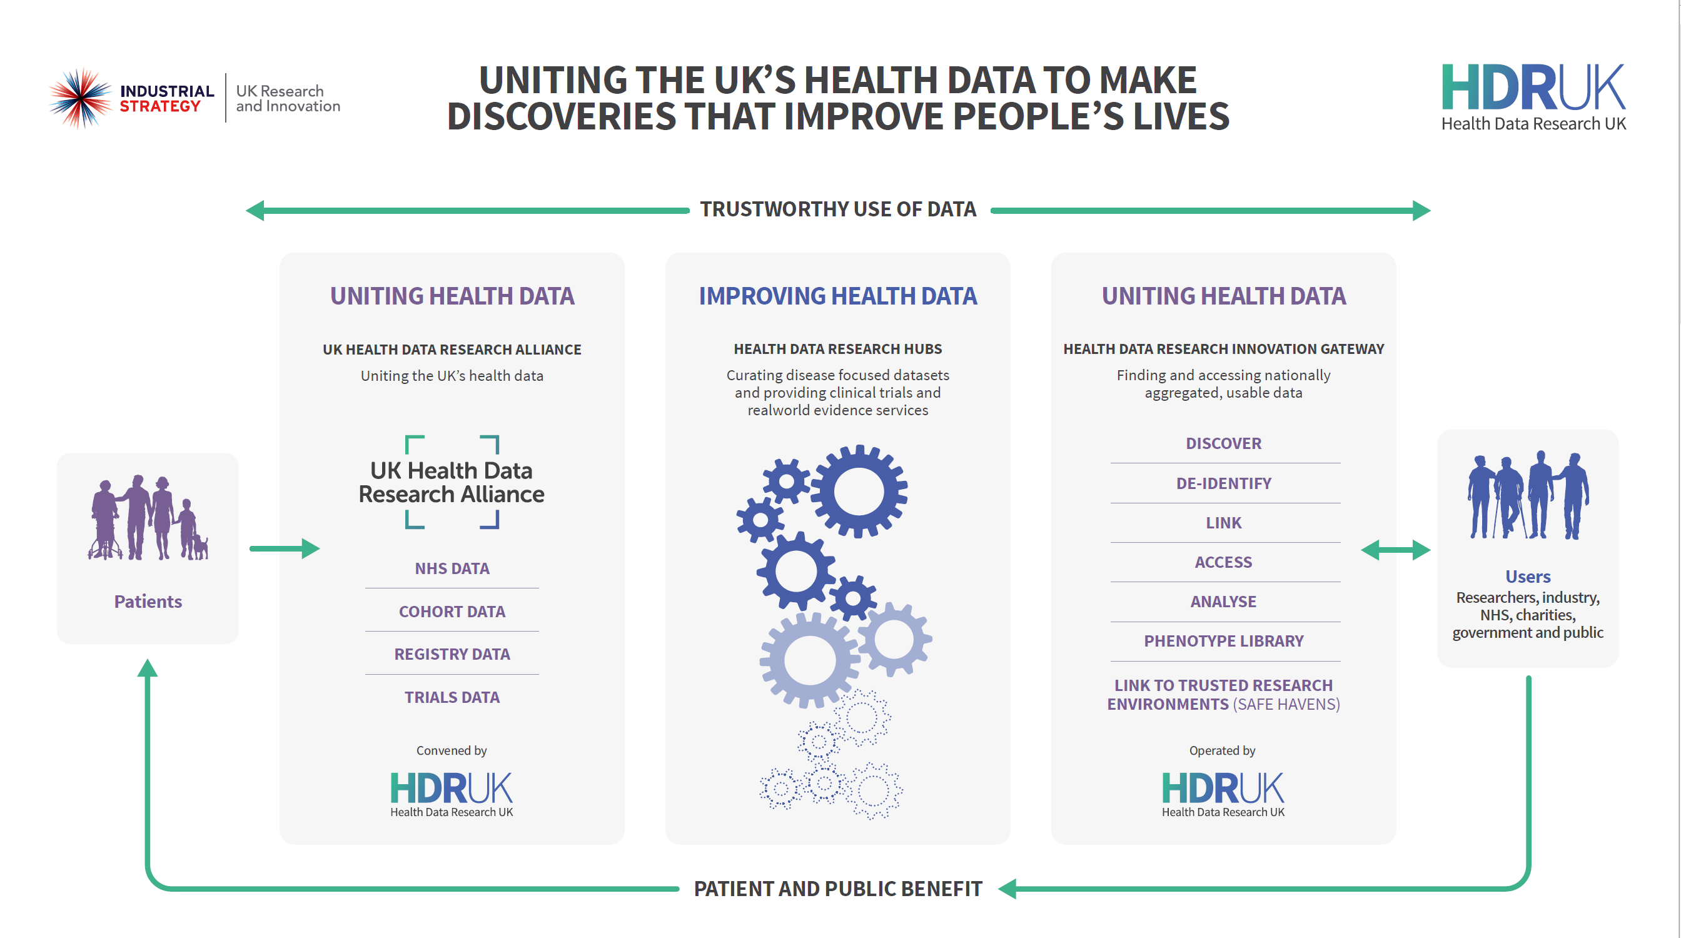
Our strategy will be delivered via the infrastructure we have started to create …

Slide 4







Improving health data
Tools, methods and hubs
IMPROVING
HEALTH DATA
Tools, methods
and hubs
HDR UK enables research and innovation by demonstrating novel approaches to health data use, impact at scale, and establishing an expert group of national research leaders in health data science to achieve:
Better, more useful, research for funders and public – that no single research organisation could achieve alone
We will achieve our aims through:
In 2020/21 we are focused on:
Tools and methods to measure and improve the utility of data discoverable through the Gateway, including applied analytics and the human phenome
8-10 Health Data Research hubs improving the data, including BREATHE, DATA-CAN, Discover-NOW, PIONEER, INSIGHT, Gut Reaction, NHS DigiTrials, and the BHF Data Science Centre
Developing an approach for evaluating data utility, improving the utility of data in hubs and developing innovative data improvement and measurement approaches
Establishing the BHF Data Science Centre
Making discoverable new tools and methods in the Gateway to improve how we describe well-being and disease (the human phenome), using applied analytics (AI) and scoping an approach to integrate social science data
APPLIED ANALYTICS
HUMAN PHENOME
BHF DATA SCIENCE CENTRE
| 4

Slide 5
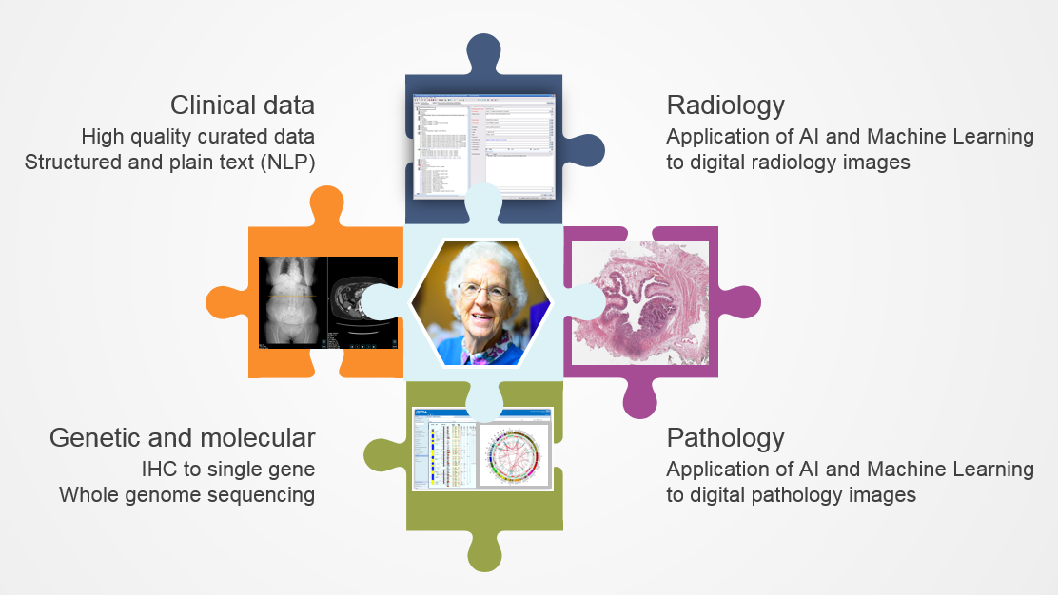






DATA-CAN
The vision on a page: linked, longitudinal records for research
Improve access
Improve quality
Ensure fair value
DATA-CAN: The Health Data Research Hub for Cancer
Notes:
I have tried to summarise the vision for DATA-CAN on a single slide.
Cancer has a strong history of national data collection and therefore a significant amount of information is collated.
But we still estimate that only forms about 10% of the data within a hospital EHR
Our ambition is to enhance the structured data collected with the information extracted from every possible source.
We will work to improve the depth, breadth and quality of data extracted from digital imaging, digital pathology, molecular and genetic and the full text narrative
In addition, we will work with data custodians across the UK to improve access to cancer data assets and ensure that commercial partnerships deliver fair value to the NHS, to the healthcare providers who have collected the data and to the patient and wider public.

Slide 6
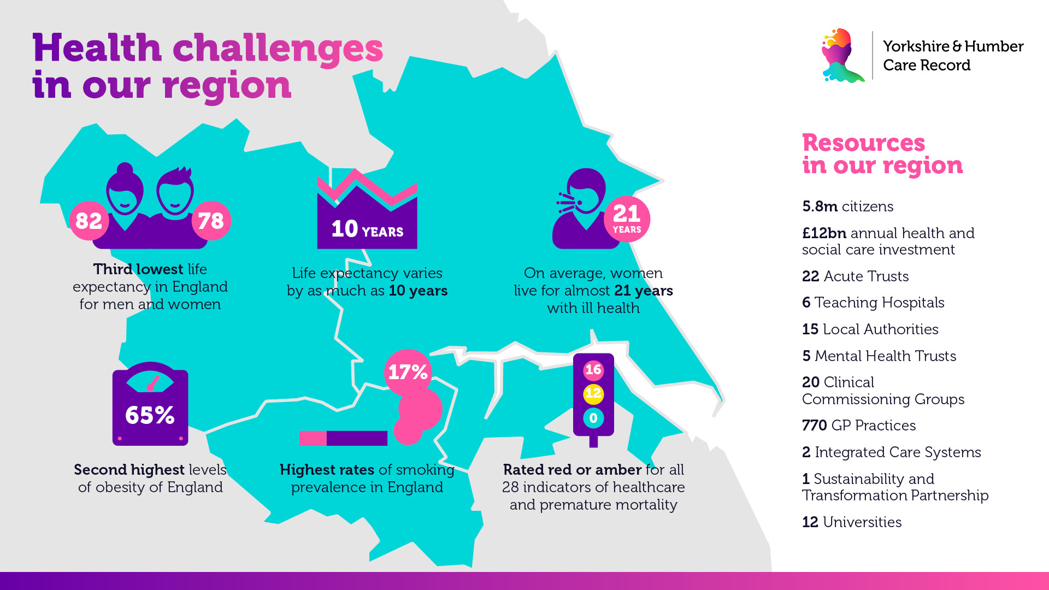

v

Slide 7
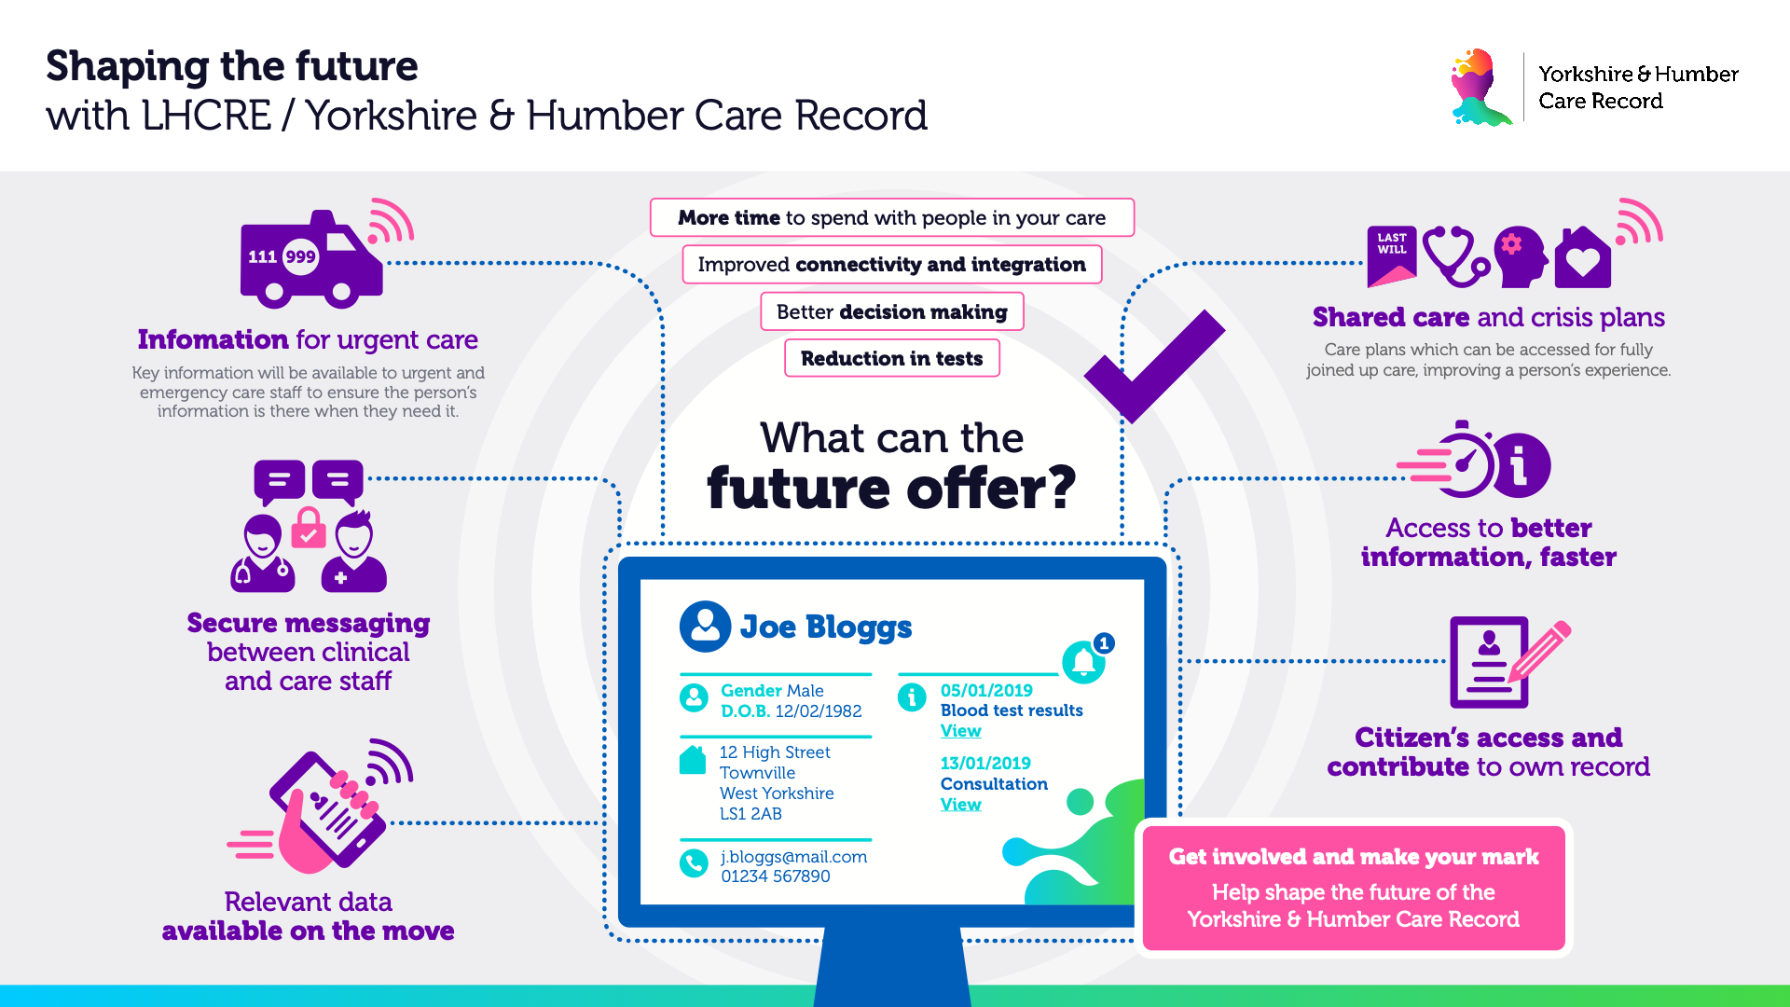
v

Slide 8
What is Population Health Management?
Recognises that health and wellbeing is more than just being ‘without disease’
It moves away from managing disease in silos to an approach based on defined populations of people, who may have multiple ‘disease conditions’
PHM hinges heavily on the use of new technologies and richer information so we have built a cloud based YH Data Ark
watch the video – which now can be found on our You Tube Channel https://www.youtube.com/watch?v=kKIfy49oqOQ

Slide 9


The Yorkshire & Humber Population Health Management Solution
A single platform for Population Health Management Analytics across the Yorkshire & Humber region
The solution, to be supported by Local Help Desks, the Y&H Central Service Management Team and suppliers, provides an advanced Population Health Management (PHM) platform which allows users
to develop analytic products that use selected data to address the objectives of a particular use case.
Population Health Management Users consist of the following:
Consumers - The colleagues who will use the solutions to improve population health e.g. Commissioners, Health Providers, Clinicians and Health & Social Care workers.
Developers - The colleagues who will build analytics solutions using the platform e.g. data engineers, data analysts, data scientists and visualisation developers.
PHM Users
Consumers
Developers
External data sources
YHCR (NHS) Population Health Management Products
The YHCR Population Health Management Products are built on the Platform and address the objectives and challenges of a particular use case in an organisation. The analytic product developed uses data to better understand patients Living with and Beyond Cancer
Each Use Case utilises the capabilities of the PHM platform to develop a dashboard or similar product which meets the specific objectives of the users designing it.
System 1
Analytics Product 1
(use case 1)
Analytics Product 2
(use case 2)
Analytics Product n
(use case n)
System 2
System 3
YHCR Population Health Management Platform
System 4
Analytics Visualisation
Management
The YHCR Population Health Management Platform, is built on Google Cloud technology and stores data that can be used to develop population health management products.
Integration Services gathers data from systems across the region using Systems of Systems (SoS).
Analytics Services enables the data to be processed and manipulated using advanced analytics tools and techniques.
Analytics Data store is the repository that securely stores the data.
Analytics Visualisation provides the tools to visualise the data.
Security and Management ensures that the access to and processing of data is protected.
System n
Security
SoS
Integration Services
Analytics Services
Analytics Data
The YHCR demo video is now saved on NHS Futures, here.

Slide 10
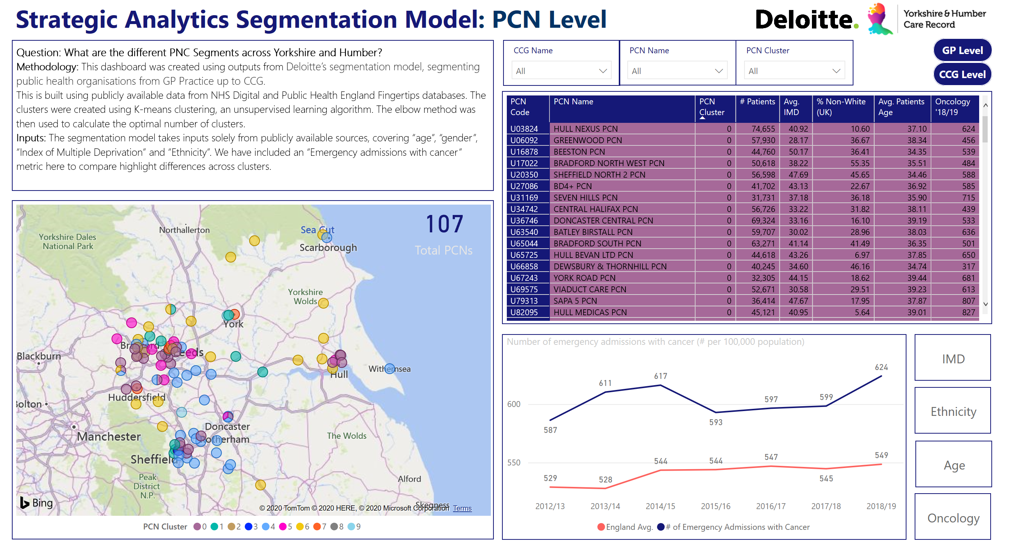

Slide 11
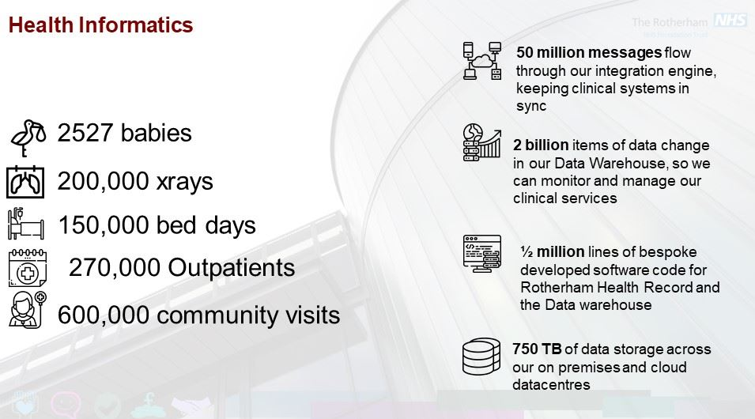

Slide 12
Use of SNOMED CT an NHS Integrated Trust
The Rotherham NHS Foundation Trust (TRFT) has implemented the Meditech EPR system which utilises SNOMED CT in line with the directives of the Personalised Health and Care 2020 framework for action and the goals stated in the Local Digital Roadmap to support the health and care community in achieving the ambition of working “Paper Free at the Point of Care”.
In addition to the strategic use of SNOMED CT, a key driving goal of the implementation was to improve the efficiency of recording patient episode information in ICD-10, for disease and OPCS-4x for procedures (classification terminologies) to support NHS reporting.
The classification terminologies group together more detailed patient information which is then used for statistical and epidemiological analysis, reimbursement for care provided and planning of health and care services.
SNOMED CT contains more detailed terms than the classification terminologies and is used by clinicians in an Electronic Patient Record System (EPR) to record, at the point of care, detailed information about a patient including but not limited to conditions, findings and procedures.

Slide 13
Clinical Ownership
Using SNOMED CT for procedure and diagnosis recording
The aim throughout has been for clinical ownership of the content in the patient record, and for that content to be of quality (completeness, level of detail and accuracy).
The rationale for requiring SNOMED CT, while accepting we would be an early adopter, was to implement the national objectives of collecting data once, at source, and facilitating other process from that data.
The data recorded should be to support clinical needs.

Slide 14
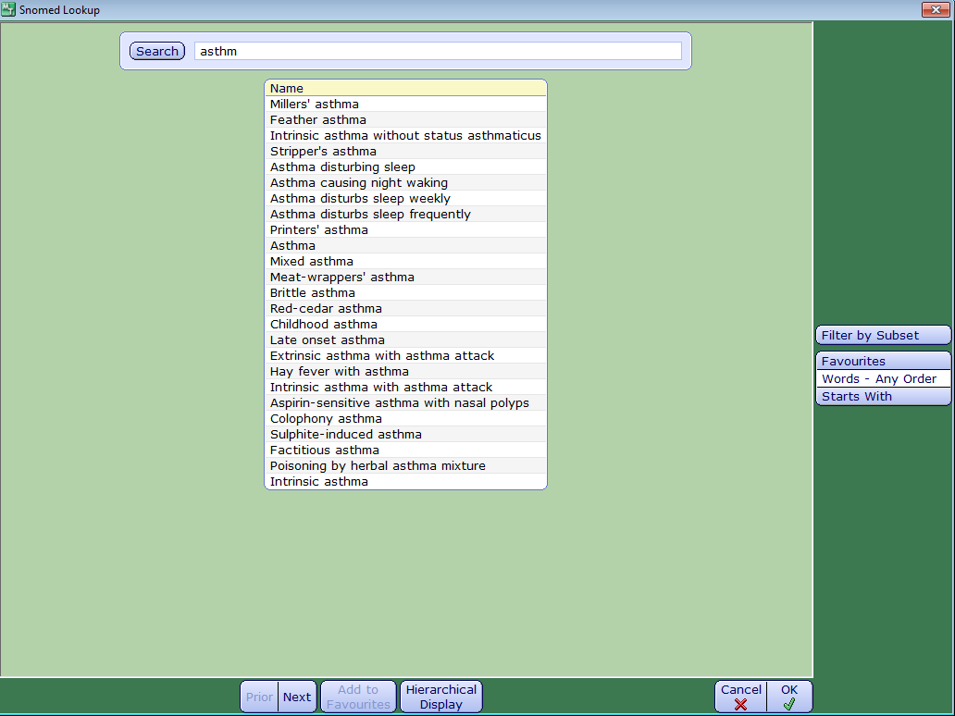
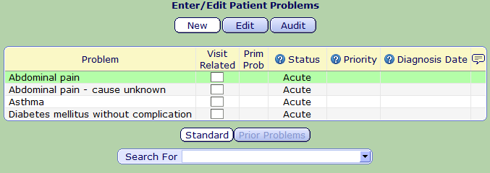
Improved Data Entry and Clinical Recording
Using SNOMED CT data entry lists (subsets) has improved the speed of data entry, achieved standardisation of recording within the hospital; improved data quality and subsequent analysis.
Some clinical specialties have championed these benefits, obstetrics and gynaecology now have a number of front-end forms that saves time for data entry, as well as reports that enable them to undertake clinical research and audits.
Previously these were undertaken by clinicians trawling through notes to identify appropriate patients. These are used to better understand and design the service offered, as well as improve patient care.

Slide 15
Benefits for the Patient
Improved visualisation of activity
Improved visibility of the clinical outpatient activity leads to much better patient care. The Trust cut outpatient waiting lists by 65% in some areas, as well as recorded a drop in the number of missed appointments (DNAs) per month
Discharge Summaries
Discharge summary is massively improved with a better level of information. This is beneficial to both GP’s and patients.
.

Slide 16
Challenges and Lessons Learned
Having SNOMED CT specialism within the Trust was essential and has enabled appropriate training and support. A mixture of face to face training, follow-up checks and work shadowing in the early phases of go-live was undertaken.
Clinicians requested a smaller choice of SNOMED CT clinical terms in data entry lookup lists. A clinical lead from each speciality was needed to help determine the correct content that should be used.
The SNOMED CT preferred term is displayed as the default display description as the system allows only one description to be used for each concept, however, the searching can be performed on all the SNOMED CT descriptions.
Upgrade the system with the current SNOMED CT release on an annual basis. The time to upgrade does need to be factored into plans which involves checking for changes in subsets and favourite folders, this is considered essential and no different to any other data set change.

Slide 17
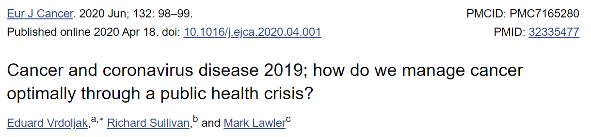
DATA-CAN
What is the link between Covid-19 and Cancer
Impact of cancer on COVID-19 infection
  Individual’s risk of infection, admission, ICU and death
  Impact of cancer site, co-morbidity
Impact of COVID-19 infection on cancer
  Impact of COVID-19 on cancer treatment and outcome
Impact of COVID-19 pandemic on cancer services
  Impact of social isolation on public
  Impact of changes to hospital services
“patients are starting to fear a COVID-19 diagnosis more than a cancer diagnosis”
Notes:
Our work on COVID-19 began like many others in HDRUK in Feb/March.
Mark Lawler, our scientific director worked with colleagues from across Europe to publish this message including the phrase “patients are starting to fear a COVID-19 diagnosis more than a cancer diagnosis.
As we discussed the problem and in particular established a dialog with colleagues at the HDRUK Centre at UCL under the leadership of Harry Hemingway it became clear that COVID-19 could affect cancer patients in a number of ways
Impact of cancer on C19 infection
Impact of COVID-19 infection on cancer, its treatment and outcome.
Impact of the COVID-19 pandemic on cancer services.
By this time, Cancer and a range of other high conditions such as heart and respiratory disease had been identified as a high risk condition and all patients, particularly those on active treatment were advised to strictly isolate
But, not all cancer patients are equal. We don’t believe that patient with early breast cancer are at the same risk as those with advanced lung cancer. Those with a history of cancer are not going to be at the same risk as newly diagnosed patients on active treatment. And what was the effect of co-morbidity, the additive effect of multiple high risk conditions
Show me the data !

Slide 18
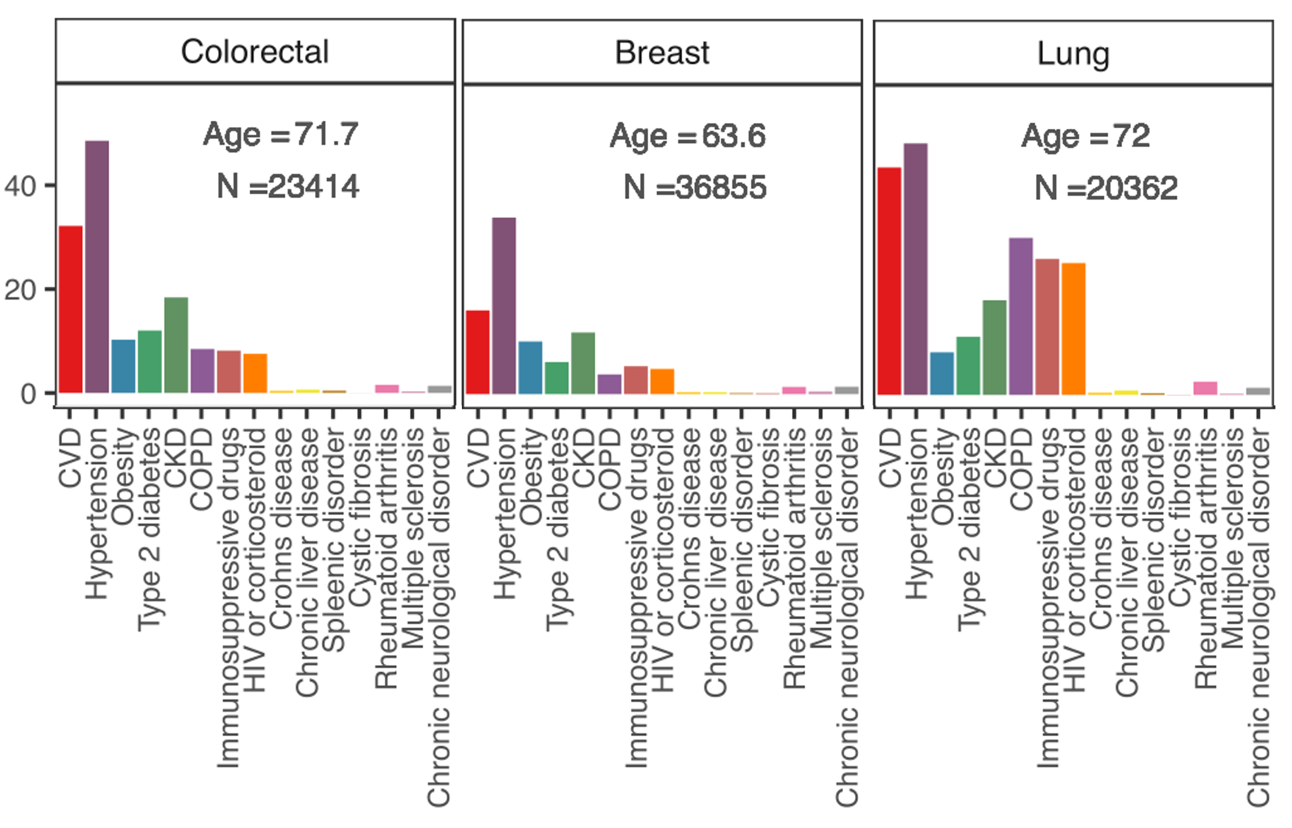
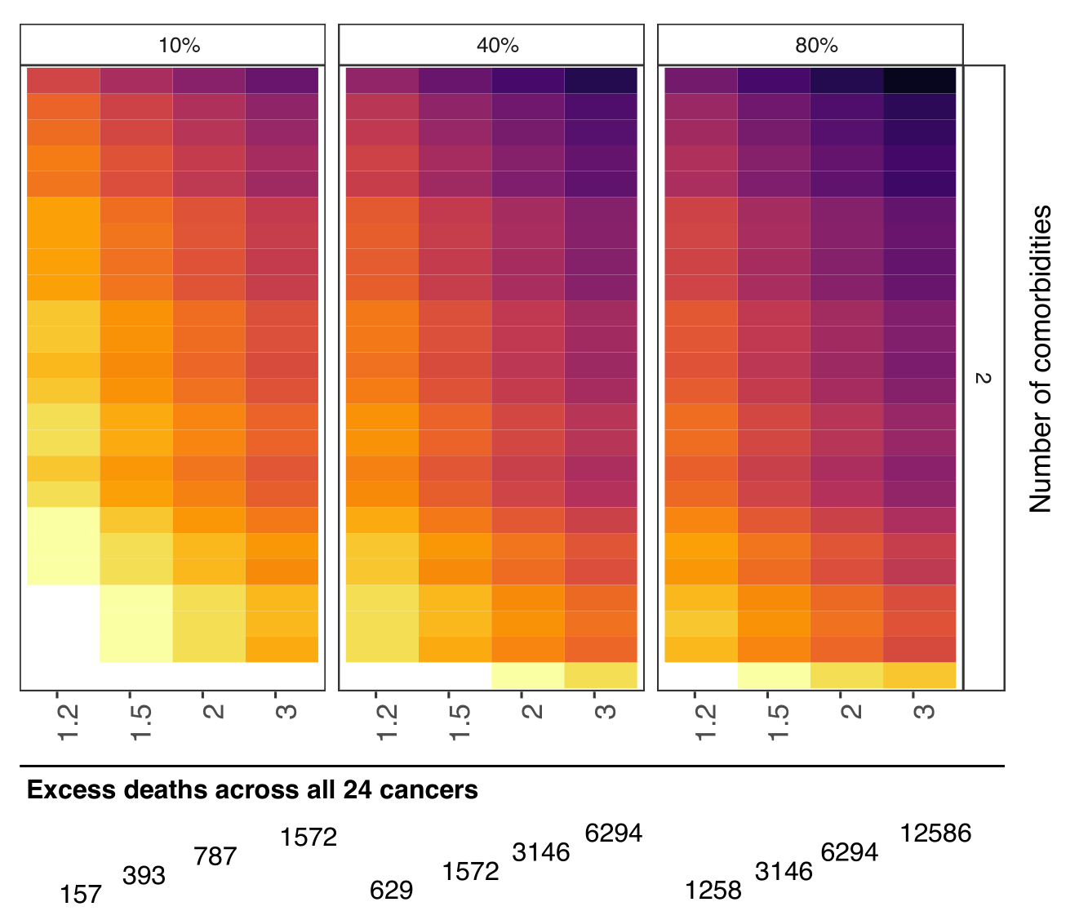
DATA-CAN: Real-time data
Reaction to COVID-19
DATA-CAN plus HDR UK Centre in London
  Impact of co-morbidity + COVID-19 on cancer deaths
  Direct effect
  CALIBER dataset – 3.86M patients, 1997 to 2017
    Primary care records (CPRD) linked to ONS
    Examined incidence and prevalence of 24 common cancers
    15 comorbid conditions defined by PHE as high-risk
    1 year mortality for each site and number of co-morbidities
    10% of patients, relative-risk of 2 - 3,137 excess deaths
Notes:
The UCL team have established a significant dataset including 3.8M primary care records from CPRD linked to Office of National Statistics
This dataset included patients with a previous history of cancer (the prevalent population) and those who a new diagnosis of cancer
It allowed us to examine the relationship between a cancer diagnosis and 15 co-morbidity phenotypes defined by the UCL team. As expected, these demonstrated clear associations that differed from cancer to cancer.
The dataset also allowed us to examine the 1 and 5 year survival for cancer patients, both the prevalent cases and the incident cases
We were then able to examine the 1 and 5 years survival for each tumour site for patients with zero, 1, 2 or 3 or more comorbid conditions.
Once we had defined this baseline data we were able to begin modelling the impact that COVID 19 would have both through direct infection (which we have ultimately defined as affecting 10% of the population over 12 months
and the additive impact of both direct and indirect effects affecting between 40 and 80% of cancer patients. We are able to calculate the excess deaths that could occur in cancer patients
Time will tell how accurate this modelling has been. But, we believe this work has real value as the country comes out of lock down allowing patients and their clinicians to make an informed choice about the risk an individual patient has

Slide 19
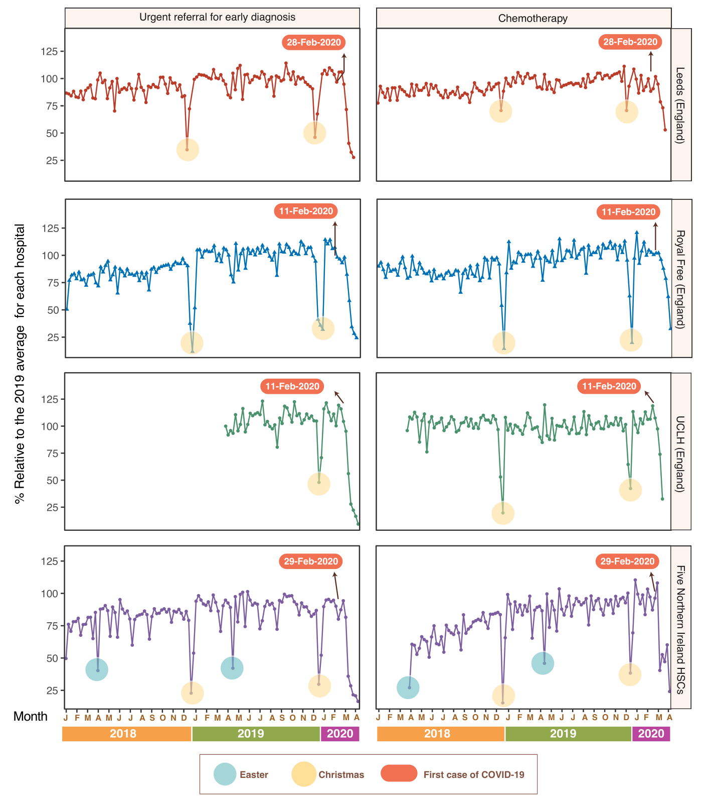
DATA-CAN: Real-time data
Reaction to COVID-19 – consistent message
DATA-CAN plus HDR UK Centre in London
  Impact of COVID-19 on cancer services
  Indirect effect
Rapid access to data across UK
  Urgent referrals & chemotherapy activity
  Leeds, London, Northern Ireland
  76% reduction in urgent referrals (range 70%-89%)
  60% reduction in chemotherapy attendances
Direct and indirect effect combined
  Estimate 6,270 - 17,915 excess deaths in 12M in people with cancer
Notes:
We also began to examine the impact of the pandemic on cancer services and here we were keen to describe the effect, not model the potential effect
We chose to markers of cancer service activity which represent different ends of the cancer pathway
Urgent referrals and chemotherapy activity
To ensure we were using the most up to date data possible we went direct to source, obtaining data from Leeds, two centres in London and all centres in N Ireland.
The consistency was surprising with a 76% reduction in urgent referrals and a 60% reduction in chemotherapy attendances.

Slide 20
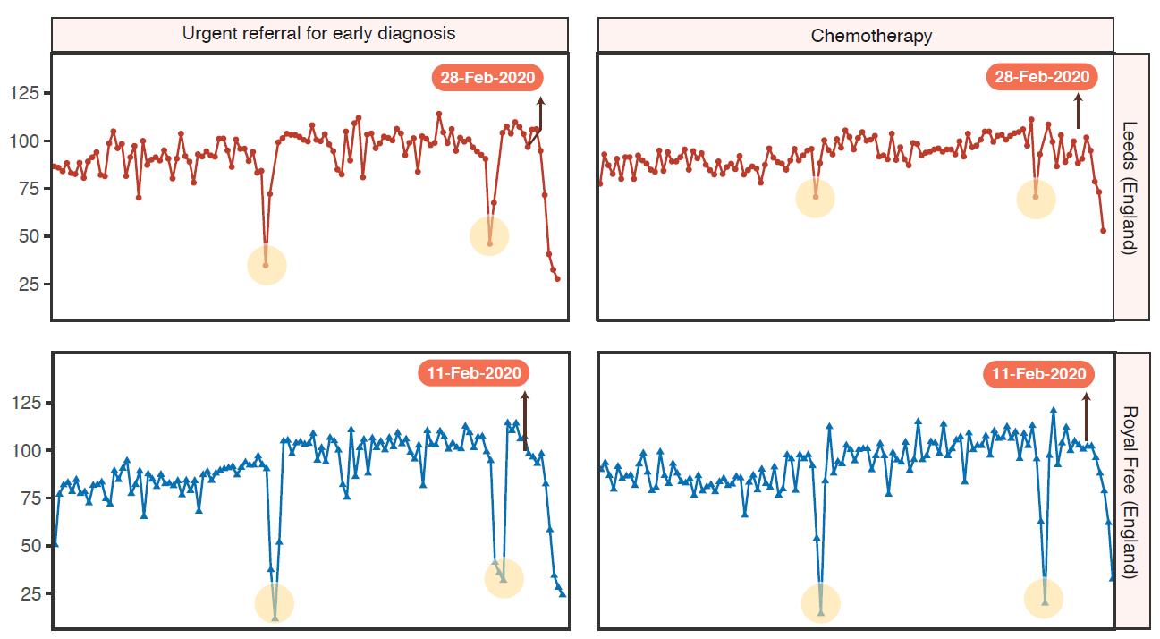

DATA-CAN: Real-time data
Reaction to COVID-19 – national consistency and regional differences
One message
One response
Notes:
Consistent but we believe also subtle differences.
The impact on urgent referrals I remarkably consistent across all of the centres with a dramatic reduction that begun almost immediately after a single message was given to the whole nation
Patient stayed at home, they protected the NHS and they did so to save lives
But with what consequence for cancer diagnosis and outcome.

Slide 21
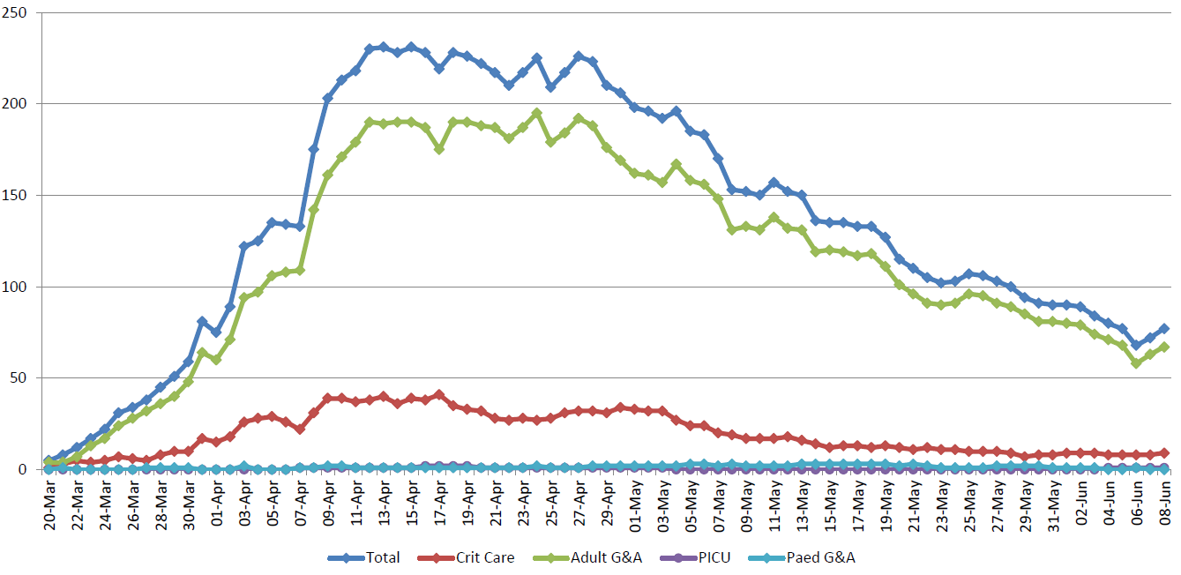
DATA-CAN: Real-time data
Reaction to COVID-19 – national consistency and regional differences
COVID-19 admission to LTHT
Local problem
Local response
Notes:
Chemotherapy activity did appear to differ between different centres. At a time when Leeds had cut chemotherapy activity by about 50%, a centre in Scotland was still at 100% of normal activity
But at that time, Leeds had ~ 200 in patients with COVID-19, the Scottish centre had only three.
We therefore suggest that differences in chemotherapy activity reflect local decisions made in response to a local problem

Slide 22
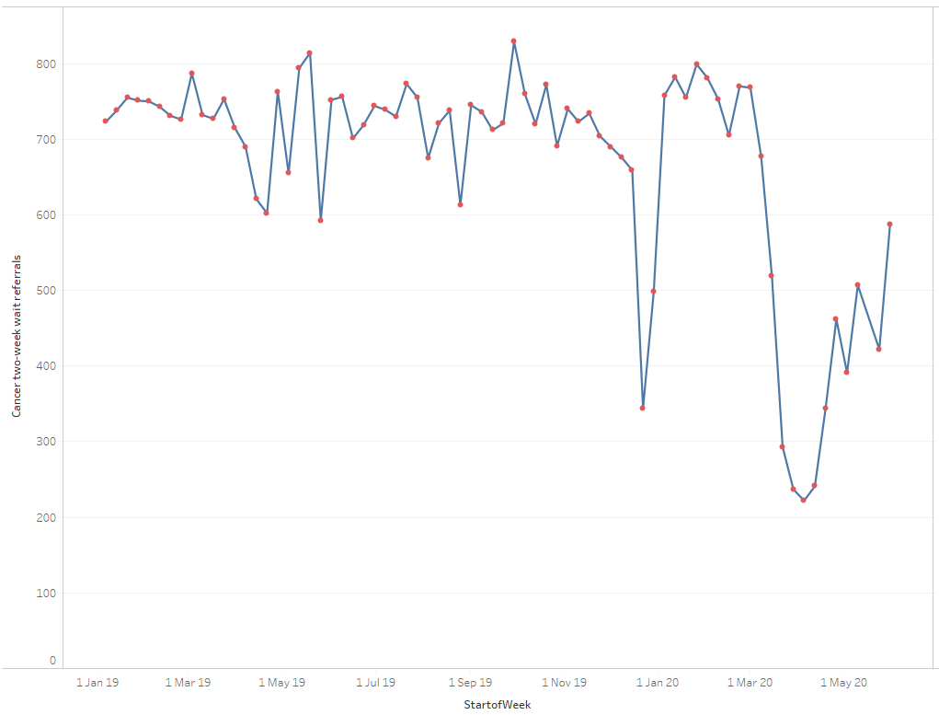
DATA-CAN: Real-time data
Future plans re COVID-19 – in support of local solutions
Impact of COVID-19 on cancer services
  Urgent referrals
  Reduction in cancer waiting time performance
  Numbers of diagnoses
  Stage at presentation
  Routes to diagnosis
  Use of surgery, SACT and radiotherapy
  1-year outcomes
  Use current datasets - common, simple, data model
  Recruit centres across UK
3,200 missing referrals - Leeds
Leeds 2WW data
(data obtained Jun 9th, includes Jun 5th 2020)
Notes:
But local data, remains more granular, more detailed and more up to date.
On Jun 11th, We were able to pull weekly (national data is monthly) data for Leeds up to and including Jun 5th
This data will mature as missing referrals are added but the message is clear
The recovery has started
The two four day weeks in May haven't helped but we are still way short of business as normal
Indeed Leeds believes it is currently missing about 3,500 2WW referrals and as a centre which reports about 1% of the referrals for the UK implies 05M missing referrals for the UK
We therefore are working with a number of centres across the UK to collect key indicators of the health of cancer services
Referrals, CWT performance, number of diagnosis
We will use current data, this is no the time for new datasets, new challenges on a service which is already struggling to cope
We will therefore collect aggregated data from centres in the UK, place that data in a TRE with controlled access allowing trusts to understand their own data and see how their recovery compares to other across the UK

Slide 23

Questions ?
NOW OR later
Monica Jones MBCS CITP MInstLM - monica.jones@nhs.net

