Slide 1


Clinical Engagement
(Getting involved)
Ian Green – Customer Relations Lead (Europe) and Global Clinical Engagement Manager
Jane Millar –Collaboration Lead (SNOMED International)

Slide 2

Clinical groups
How to get involved…
Agenda

Slide 3


SNOMED International
with clinical engagement
SNOMED CT, enhanced by clinicians to support current and future clinical practice
Timely responses to clinical advances
Clinically assured SNOMED CT content
Development of clinically supportive derivatives
CLINICAL
ENGAGEMENT
Clinical input into future developments
Development of clinically responsive educational materials
Corporate culture driving clinically assured product development
Clinically driven implementation support

Slide 4

SNOMED International
Clinical Reference Groups
Project Groups
Editorial groups (as required)
Member led clinical activity
Members may have their own clinical engagement activities (Varies from country to country)
Focus can be different between countries
(For example, content or implementation focus)
Check with individual national release centres (NRCs)
Contact details for individual Members: http://snomed.org/members
Clinical Groups
4

Slide 5

Clinical Reference Groups
Clinical Communities
Clinical
Reference Groups
Project Group
SNOMED CT
Editorial Group
Clinical
Coordination Function

Slide 6

Clinical Reference Groups (CRGs)
Enable topic focused discussions between clinicians
Provides a platform for clinicians to discuss issues and experience relating to SNOMED CT implementation
Dedicated web sites to support discussion
Open and transparent
(does not require an account to access)
Open to all, input not limited to just clinicians from the clinical specialty
Task and finish project groups (and Editorial groups) are linked to the CRGs
KEY: We all have experiences, and we can all learn from each other

Slide 7

  Facilitate multi-disciplinary topic discussion and working across professions
  Access to expertise from all clinical domains
  International focus
  A mechanism for different levels of engagement
  Access to discussions in other groups
  Early identification of global changes to healthcare delivery
Clinical Reference Groups
What is the Expectation?
7

Slide 8


Clinical Reference Groups
How to get involved...

Slide 9

How to Join
Existing CRGs
All CRG pages are hosted on Confluence
Pages are open, and can be viewed by anyone with no log in restrictions
However, to participate in discussions, you must be logged in to Confluence
To obtain a Confluence account
http://snomed.org/accounts
Please advise us if joining a group
info@snomed.org

Slide 10
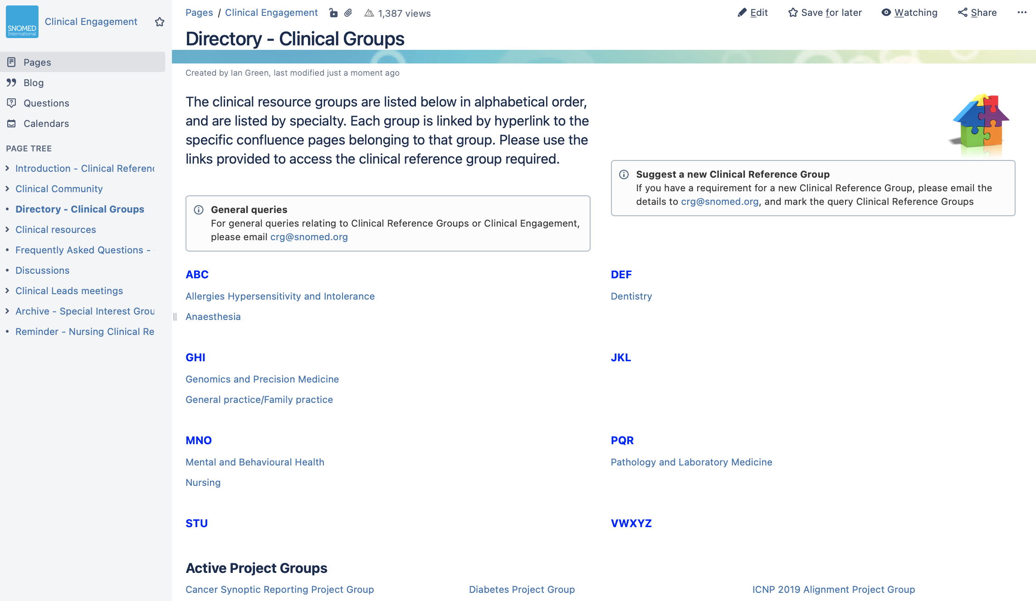
Directory of
Clinical Groups
Hosted on Confluence
Listed in alphabetical order, by specialty
To learn more visit: http://snomed.org/crg

Slide 11
Clinical Reference Groups
Allergies (Bruce Goldberg, Lead)
Anesthesia (Patrick McCormick, Andrew Norton and Andrew Marchant, co-leads)
Dentistry (Mark Jurkovitch and Jorn Jorgensen, co-leads)
Genomics and Precision Medicine (Ian Green and Charles Gutteridge, co-leads)
General Practice and Family Practice (Ian Green and Jane Millar, co-leads)
Mental and Behavioral Health (Piper Ranallo and Michael First, co-leads)
Nursing (Erica Culp and Christing Spisla, co-leads)
Pathology and Laboratory Medicine (W. Scott Campbell and Daniel Karlsson, co leads)
CRG’s
Project Groups
Cancer Synoptic Reporting group (W. Scott Campbell, lead)
Diabetes project group (Paul Amos, lead)
Epilepsy Clinical Expert Project group (Helen Cross, lead)
Nutrition Care process Terminology Clinical Project Group (Constantina Papoutsakis, lead)
Project
groups

Slide 12

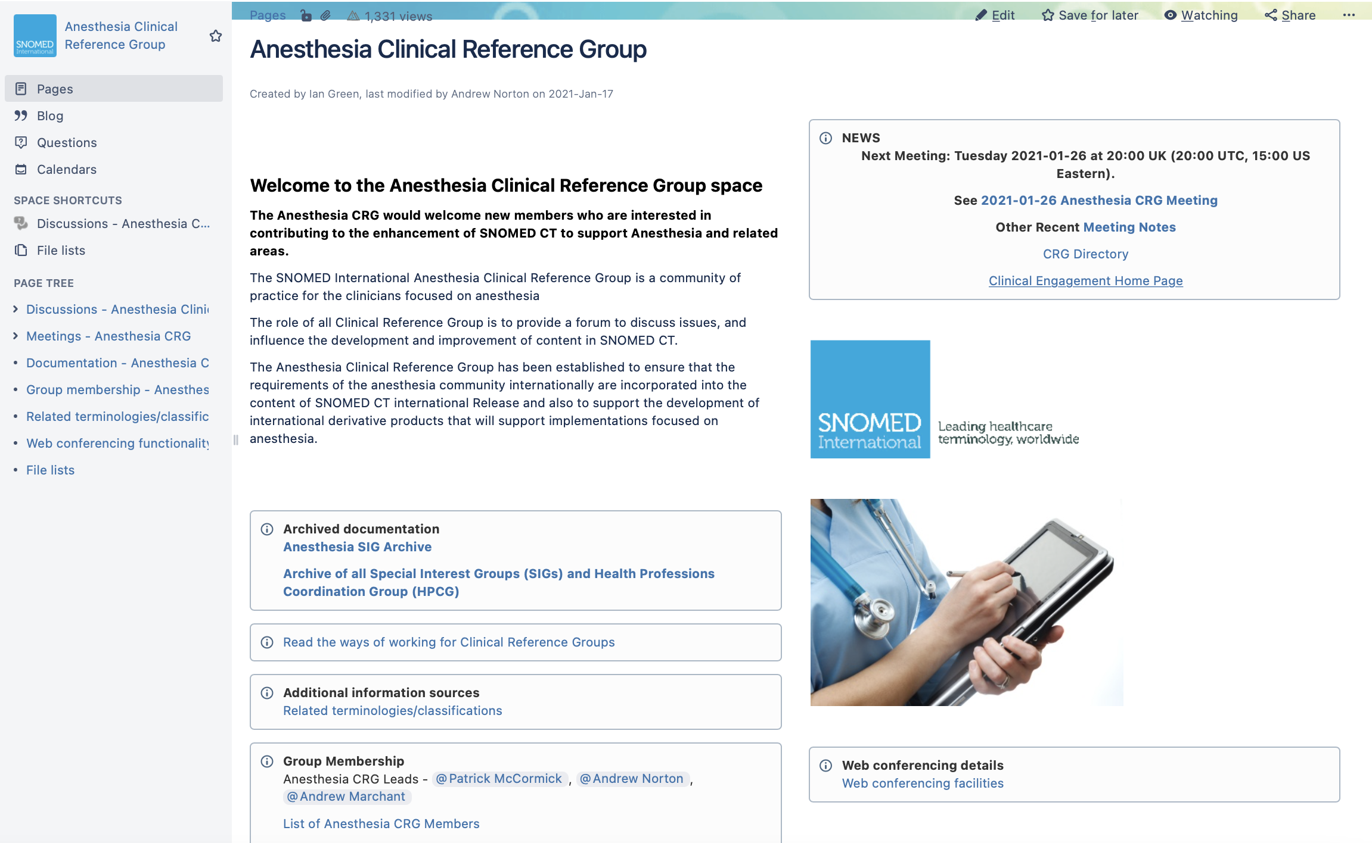
Working with
Confluence and a clinical group

Slide 13
Examples of current focused work of clinical groups
Dentistry CRG
Adding to odontogram and periodontal content
Nursing CRG
Incorporation of ICNP with international review and validation
Nutrition Care Process Terminology Clinical Project Group
Incorporation of NCPT with international review and validation
Anesthesia CRG
Ongoing updating and creating content, current focus is assessment scales

Slide 14
New CRGs under consideration
Public health – focus: use of SNOMED CT by public health bodies, particularly for population-based analytics
Emergency medicine – focus: use of SNOMED CT in emergency settings
Neurology – focus: use of SNOMED CT content related to neurology and neurosurgery
Nutrition and dietetics – move the project group to a CRG for longer term support
Future developments
Clinical reference groups

Slide 15
Clinical webinars – focus on SNOMED CT clinical implementation
Conference sessions – two sessions per year based on SNOMED International conferences (April & October)
Educational materials – clinical course, and selection of materials available from SNOMED International and other sources
  (https://courses.ihtsdotools.org/product?catalog=CLI, & https://confluence.ihtsdotools.org/display/CP/Clinical+resources)
Topic-based calls – development of specific conference calls focused on specific topics identified by the community
Clinical contact database (SME access) – database of clinicians who are willing to be contacted regarding authoring queries
Clinical engagement
Activities/resources

Slide 16


THANK YOU
SNOMED International: Delivering SNOMED CT

